Slide 1



Atty. Jose Neil D. Lumongsod, CPA
City Accountant, City of Bogo
LYDO-Designate
Financial Reports and Registries for SK Transactions

Slide 2
Financial Reports and Registries for SK Transactions
Atty. Jose Neil D. Lumongsod, CPA
City Accountant, City of Bogo
Former LYDO-Designate

Slide 3



PRIOR KNOWLEDGE
TEST

Slide 4
No. 1
When shall the Barangay Treasurer inform, in writing, the SK chairperson and the SK treasurer of the estimated 10% of the general fund of the barangay for the ensuing fiscal year?

Slide 5
No. 1
When shall the Barangay Treasurer inform, in writing, the SK chairperson and the SK treasurer of the estimated 10% of the general fund of the barangay for the ensuing fiscal year?
Answer: On or before September 15

Slide 6
No. 2
What refers to a financial plan embodying the estimate of receipts and payments for one fiscal year operation of the SK, approved by the SK through a Resolution before the start of the succeeding fiscal year, and should be consistent with the Comprehensive Barangay Youth Development Plan (CBYDP) and Annual Barangay Youth Investment Program (ABYIP)?
Notes:
Approved Budget

Slide 7
No. 2
What refers to a financial plan embodying the estimate of receipts and payments for one fiscal year operation of the SK, approved by the SK through a Resolution before the start of the succeeding fiscal year, and should be consistent with the Comprehensive Barangay Youth Development Plan (CBYDP) and Annual Barangay Youth Investment Program (ABYIP)?
Answer: Annual Budget

Slide 8
No. 3
What refers to the amount committed to be paid by SK for any lawful payments to be made by the accountable officer for and in behalf of the SK officer?
Notes:
Commitment

Slide 9
No. 3
What refers to the amount committed to be paid by SK for any lawful payments to be made by the accountable officer for and in behalf of the SK officer?
Answer: Commitment

Slide 10
Q4
What constitute all cash paid out during a given period in currency (cash) or by check? It may also mean the settlement of government payables by cash or check. Payments shall be made on duly approved Disbursement Voucher (DV).
Notes:
Commitment

Slide 11
No. 4
What constitute all cash paid out during a given period in currency (cash) or by check? It may also mean the settlement of government payables by cash or check. Payments shall be made on duly approved Disbursement Voucher (DV).
Answer: Disbursement/Payment

Slide 12
Q5
What refers to the original budget adjusted for transfers, allocations and other authorized changes applicable to the budget period?
Notes:
Commitment

Slide 13
No. 5
What refers to the original budget adjusted for transfers, allocations and other authorized changes applicable to the budget period?
Answer: Final Budget

Slide 14
Q6
What refers to the initial approved budget for the budget period?
Notes:
Commitment

Slide 15
No. 6
What refers to the initial approved budget for the budget period?
Answer: Original Budget

Slide 16
Q7
What constitute all collections during a given period in cash, in check and/or direct deposit to the SK bank account?
Notes:
Commitment

Slide 17
No. 7
What constitute all collections during a given period in cash, in check and/or direct deposit to the SK bank account?
Answer: Receipts/Collection

Slide 18
Q8
What include, but are not limited to, the following:
Ten percent of the general fund of the Barangay;
Proceeds from fund-raising activities that are in line with CBYDP and ABYIP;
Contributions, monies and all other resources received without specific purposes; and
Funds received for specific purposes?
Notes:
Commitment

Slide 19
No. 8
What include, but are not limited to, the following:
Ten percent of the general fund of the Barangay;
Proceeds from fund-raising activities that are in line with CBYDP and ABYIP;
Contributions, monies and all other resources received without specific purposes; and
Funds received for specific purposes?
Answer: SK Funds

Slide 20
Q9
What refers to additional budget approved by the SK to augment the original annual budget if the SK funds allow? It shall be in accordance with the adopted ABYIP.
Notes:
Commitment

Slide 21
No. 9
What refers to additional budget approved by the SK to augment the original annual budget if the SK funds allow? It shall be in accordance with the adopted ABYIP.
Answer: Supplemental Budget

Slide 22
No. 10
What refers to the 3-year rolling plan of the Sangguniang Kabataan?

Slide 23
No. 10
What refers to the 3-year rolling plan of the Sangguniang Kabataan?
Answer: Comprehensive Barangay Youth Development Plan (CBYDP)

Slide 24
No. 11
Who will authorize the SK Budget?

Slide 25
No. 11
Who will authorize the SK Budget?
Answer: Sangguniang Kabataan Members

Slide 26
No. 12
True or False. No procurement shall be undertaken unless in accordance with the Annual Procurement Plan (APP)

Slide 27
No. 12
True or False. No procurement shall be undertaken unless in accordance with the Annual Procurement Plan (APP)
Answer: TRUE

Slide 28
No. 13
SK financial transactions shall be kept under __________ basis of accounting using a ______________system and recorded in accordance with the list of accounts provided in the HFTSK.

Slide 29
No. 13
SK financial transactions shall be kept under __________ basis of accounting using a ______________________________system and recorded in accordance with the list of accounts provided in the HFTSK.
cash
single-entry bookkeeping

Slide 30
SK Plans and Budget

Slide 31
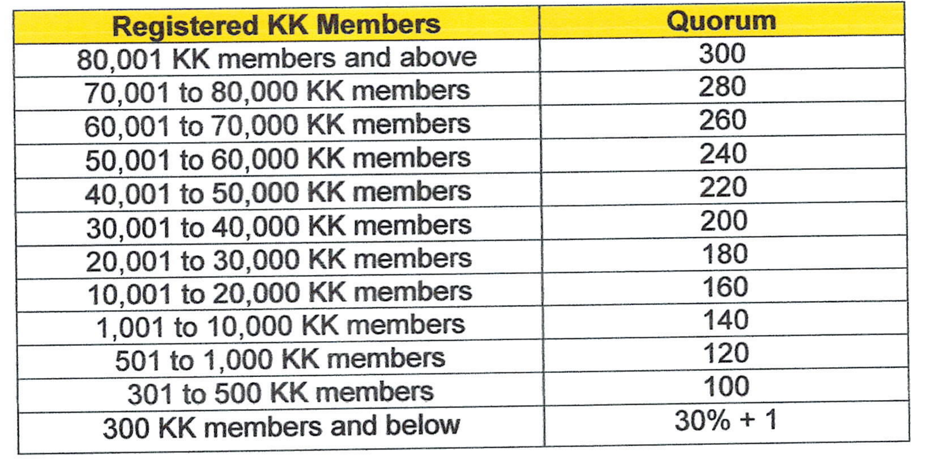

PLANNING PROCESS
KK Profiling and Consultation
The SK shall conduct KK Profiling pursuant to DILG MC 2022-033; while the quorum for KK Assemblies is governed by DILG MC 2022-032.
1
CBYDP Formulation
The SK, in consultation with the Katipunan ng Kabataan, shall
formulate a 3-year rolling plan. This plan shall be aligned with the PYDP and LYDPs in provincial, city or municipal level. The CBYDP shall serve as the basis for the preparation of the ABYIP.
2
ABYIP Formulation
The ABYIP shall contain the specific programs, projects, and activities with corresponding project costs, including the necessary fund flows to approximate the reasonable timing in the release of funds. It shall reflect the total resource requirement for the budget year.
3
4
Approval of ABYIP
The ABYIP shall be prepared and approved by the SK through a
resolution before the start of the preparation of the SK annual
budget.

Slide 32
Important Notes in Planning
Check CBYDP vs. ABYIP
a) PPAs in the ABYIP must be found in the CBYDP
b) Amounts per PPA in the ABYIP must not exceed in
the CBYDP
c) Total budgetary requirement of ABYIP must not exceed CBYDP
d) Must provide PPAs for Honoraria in Governance both
for CBYDP and ABYIP
d) Must provide PPAs for General Administration
Program in ABYIP and CBYDP under Governance
e) PPAs must be aligned to its Center of Participation

Slide 33
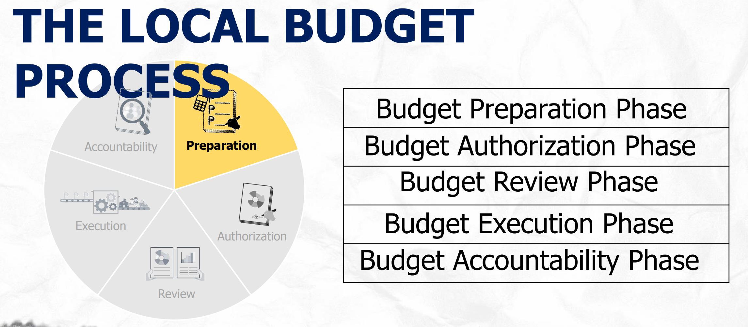
BUDGET CYCLE

Slide 34
Reminders for Budgeting
All SK positions even if vacant must be allocated with honoraria
Consider other centers of participation not allocated in the previous year’s budget
Must use the Accounts per COA Handbook
Honoraria must not exceed 25% of the 10% SK share
Honoraria allocation in the budget must not exceed in the amount per ABYIP and CBYDP

Slide 35
Reminders for Budgeting
Check Annual Budget vs. ABYIP
Expected Result and Performance indicator in the Annual Budget must be found in the ABYIP
Amounts per PPA in the Annual Budget must not exceed in the ABYIP
Total budgetary requirement per center of participation in the Annual Budget must not exceed the ABYIP
Total Expenditures must not exceed total income/receipts

Slide 36
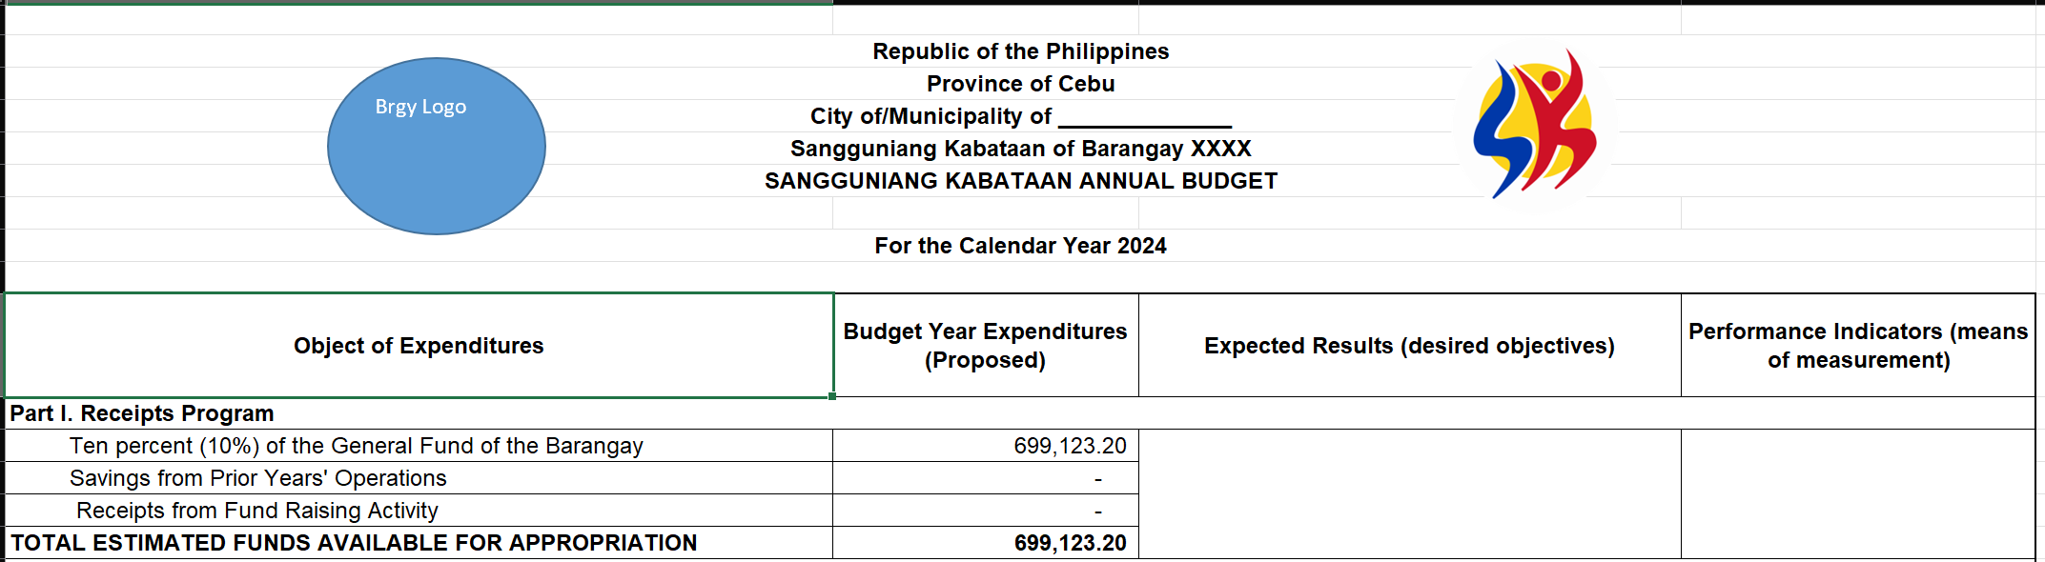
Sample SK Budget

Slide 37
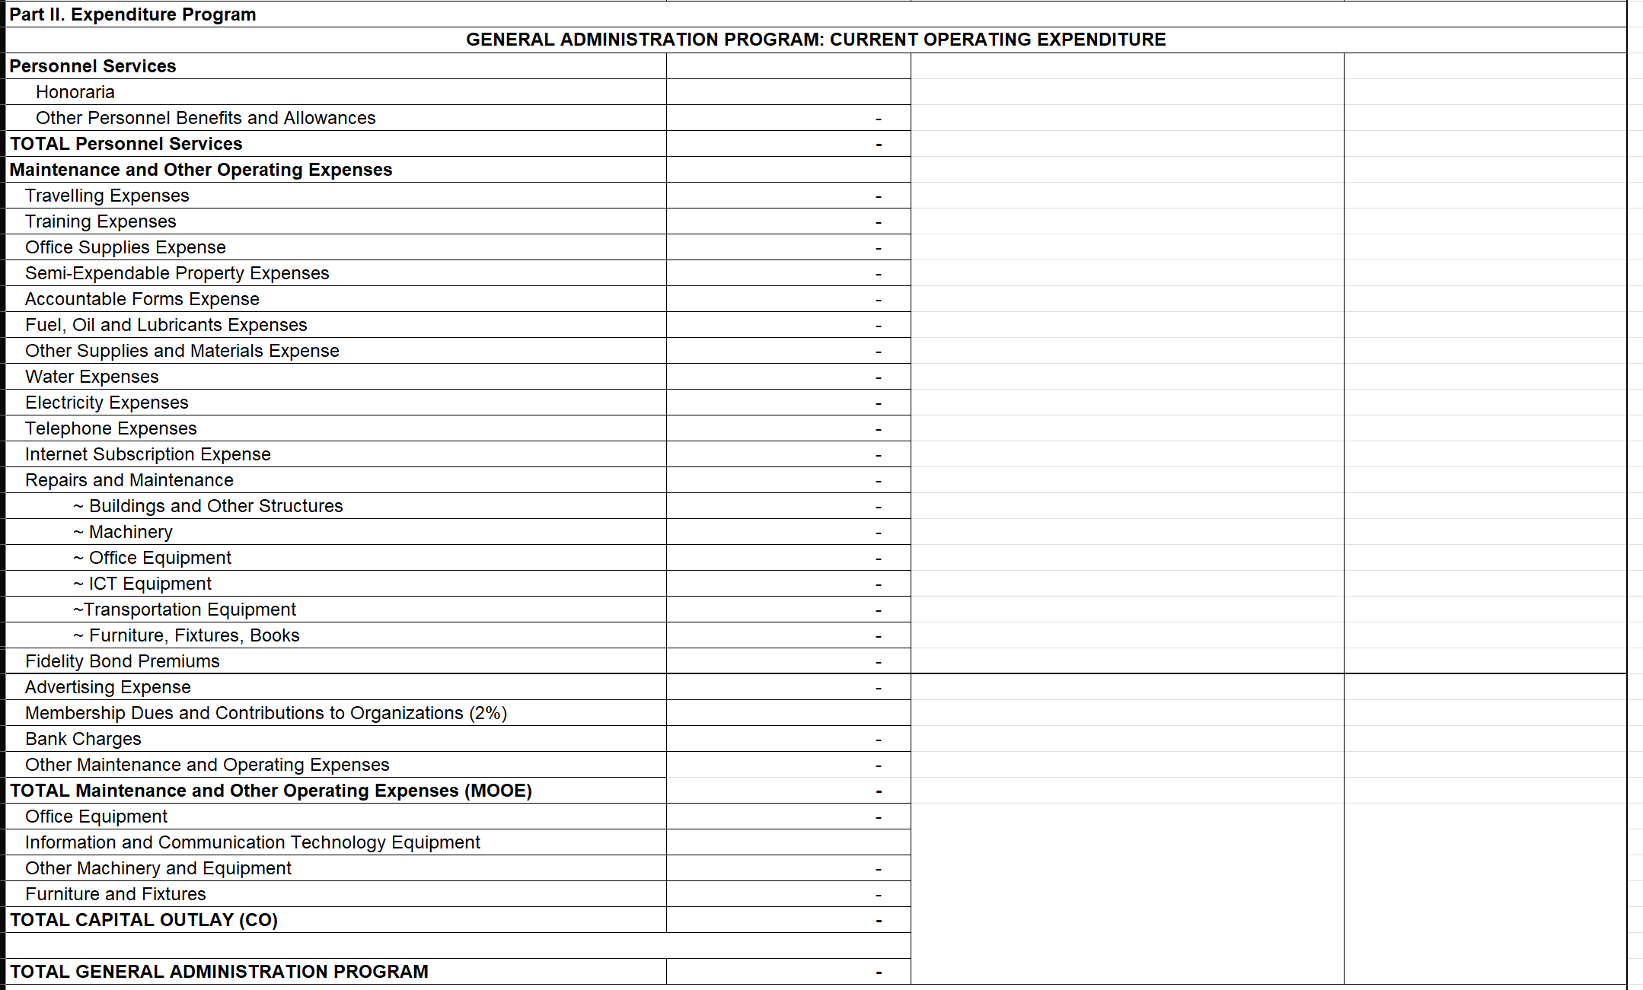
Sample SK Budget

Slide 38
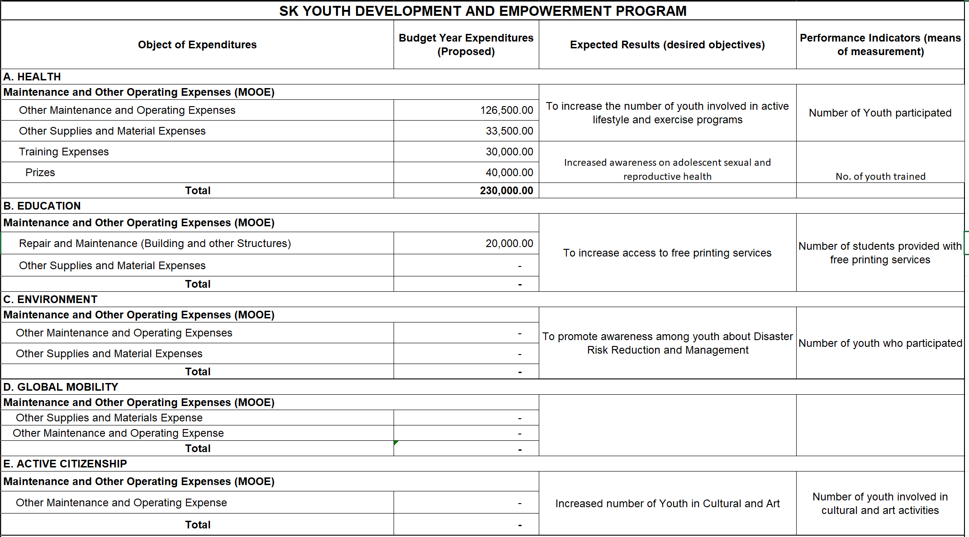
Sample SK Budget

Slide 39
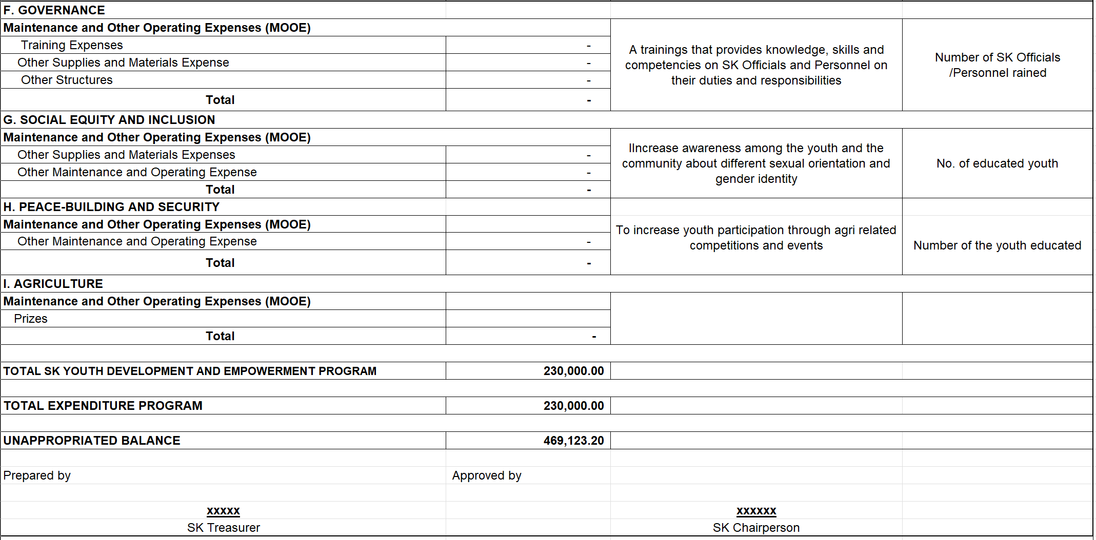
Sample SK Budget

Slide 40
Print and Compile in the ff order:
Endorsement
Annual Budget Landscape
SK Reso Approving Annual Budget
Annex “A” - Comprehensive Barangay Youth Development Plan
Annex “B” - SK Secretary’s Certificate
Annex “C” - SK Resolution No. ____, series of 202__,
Resolution Approving the CBYDP
Annex “D” - 2025 Annual Barangay Youth Investment Program
Annex “E” - SK Resolution No. ____, series of 202__,
Resolution Approving the 2025 ABYIP
Annex “F” - Barangay Treasurer’s Letter
Annex “G” - SK Annual Budget (Portrait)
Annex “H” - Plantilla of Personnel
Annex “I” - Annual Procurement Plan

Slide 41
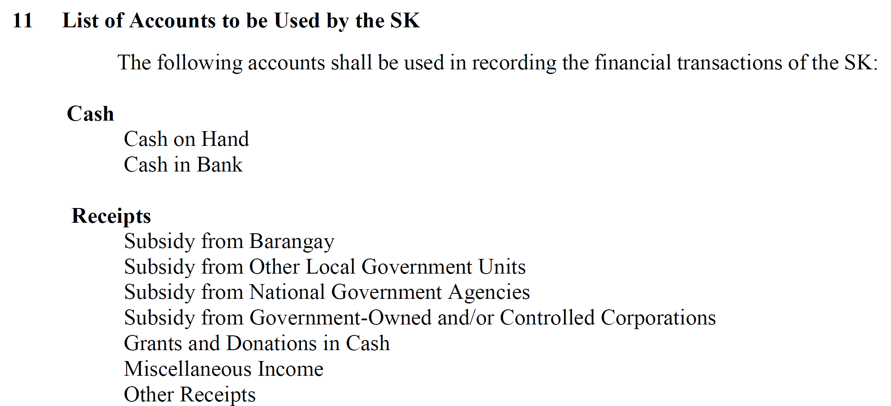

Slide 42
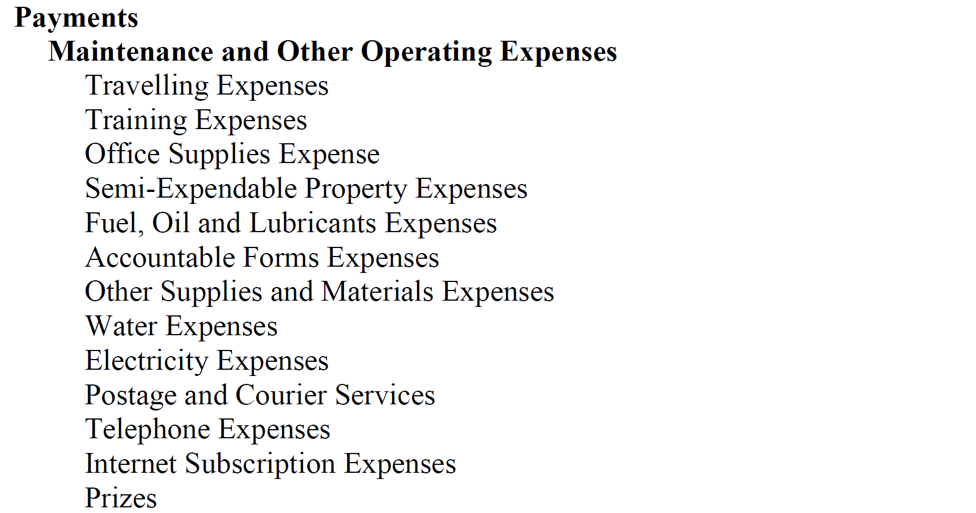

Slide 43
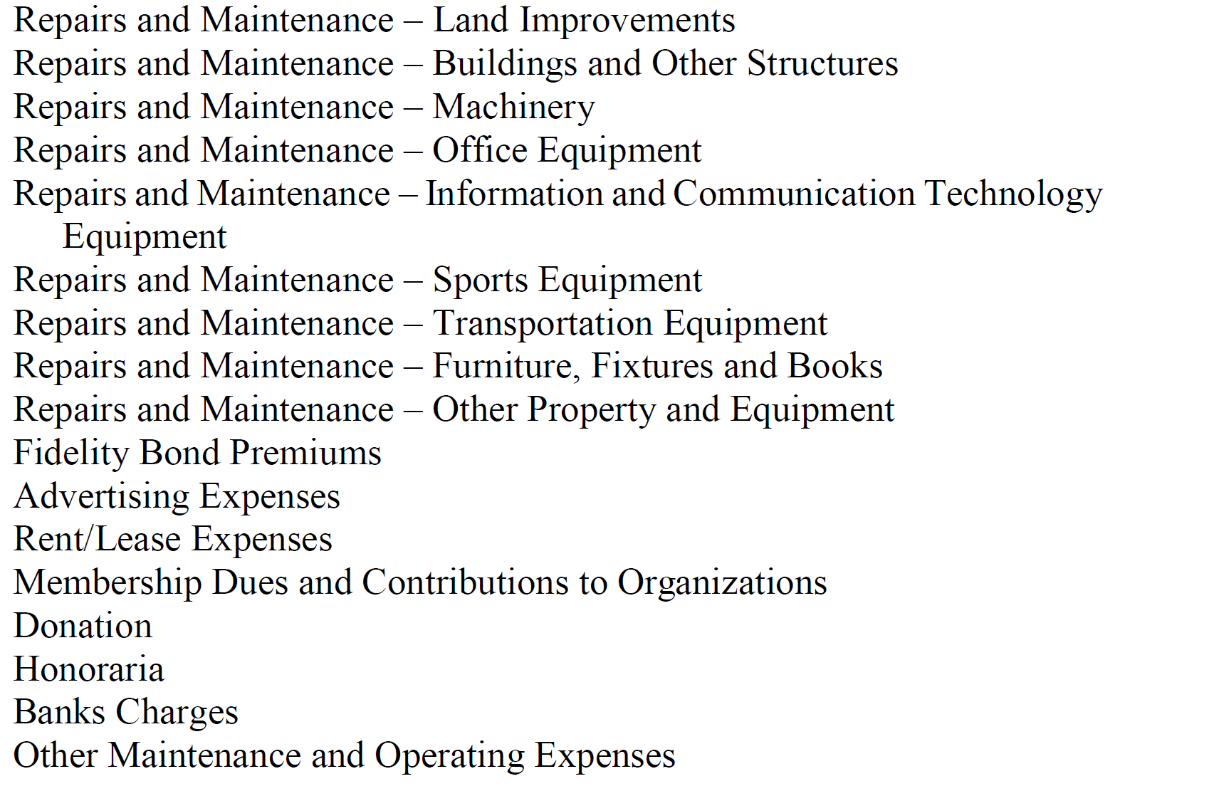
List of Accounts

Slide 44
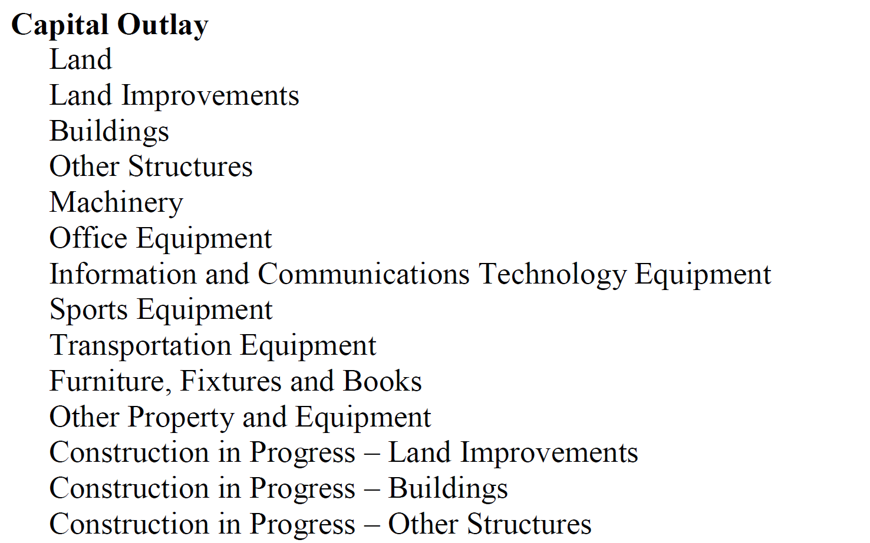
List of Accounts

Slide 45
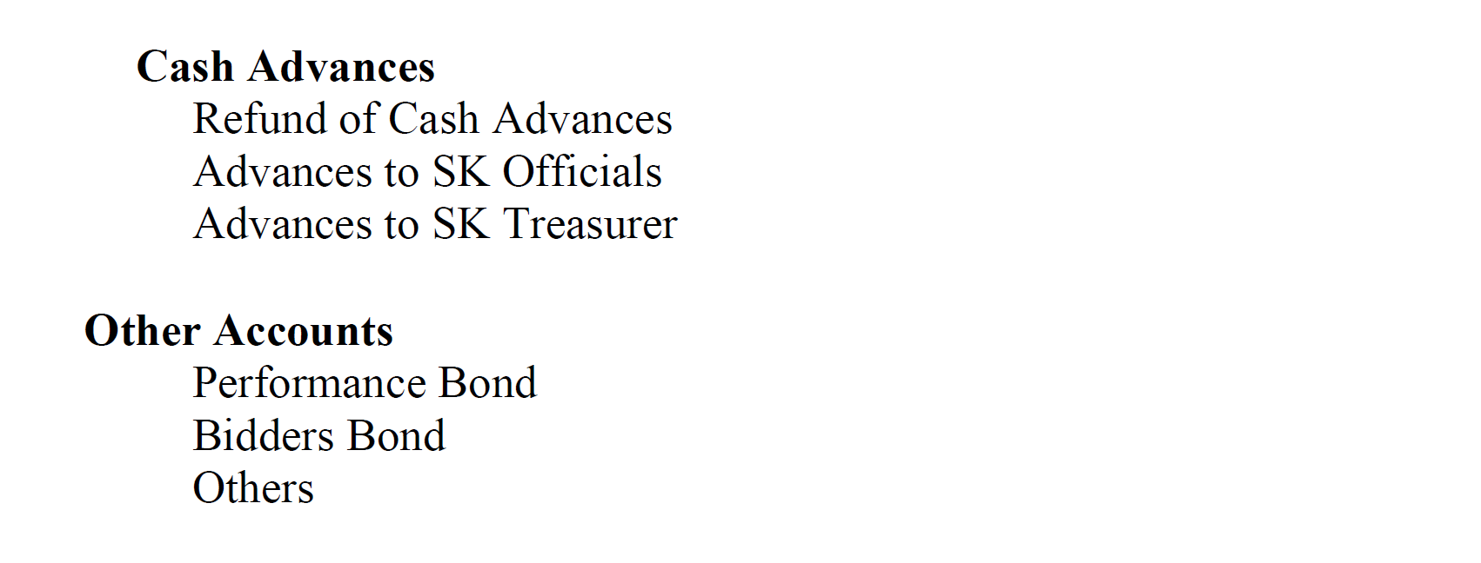
List of Accounts

Slide 46
Atty. Jose Neil D. Lumongsod, CPA
City Accountant, City of Bogo
LYDO-Designate
Financial Reports and Registries for SK Transactions

Slide 47
Financial Reports and Registries for SK Transactions
Atty. Jose Neil D. Lumongsod, CPA
City Accountant, City of Bogo
Former LYDO-Designate

Slide 48


HANDBOOK ON
THE FINANCIAL TRANSACTIONS
OF THE
SANGGUNIANG KABATAAN (SK)
Notes:
Good morning! Our topic for today is about the HFTSK. The goal is to give you an overview of the Handbook

Slide 49
Monthly Reports
Report | Prepared by | Submitted to | Deadline
Bank Reconciliation Statements (BRS) | SK Treasurer | COA Auditor | On or before the 20th day of the following month

Slide 50
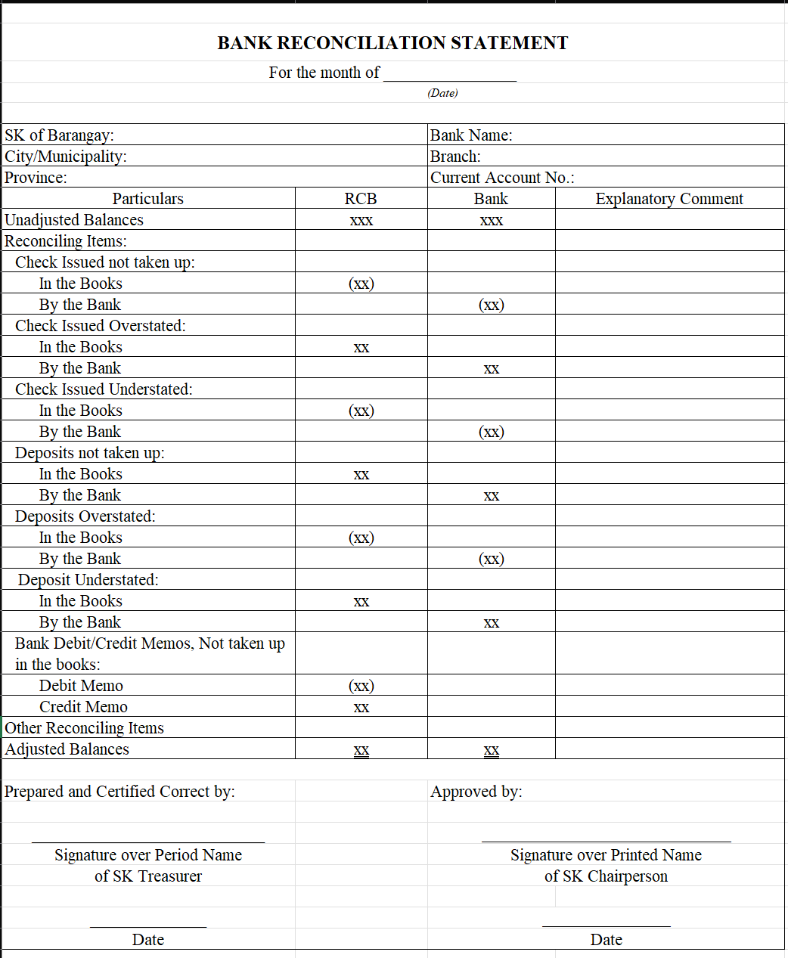

Slide 51
Quarterly Reports
Report | Prepared by | Submitted to | Deadline
Statement of Receipts and Payments (QSRP) | SK Treasurer | SK, SB and COA Auditor | within 20 days after the end of each quarter
Report of Accountability for Accountable Forms (RAAF) | SK Treasurer | SK Chairperson and COA Auditor | within 20 days after the end of each quarter
Summary of Budget, Commitments, Payments and Balances (SBCPB) | Budget Monitoring Officer | SK, SB and COA Auditor | within 20 days after the end of each quarter
Summary of Specific Purpose Fund, Commitments, Payments and Balances (RSPFCPB) | Budget Monitoring Officer | SK, SB and COA Auditor | within 20 days after the end of each quarter

Slide 52
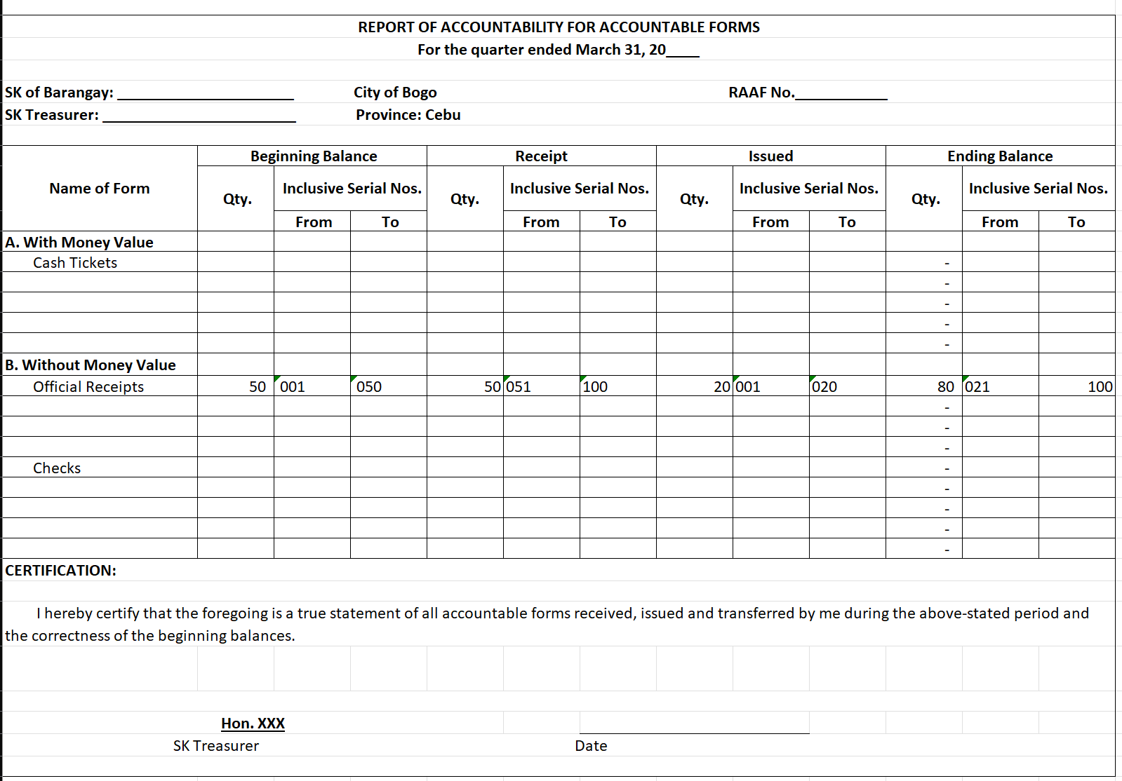

Slide 53
Semi-Annual Reports
Report | Prepared by | Submitted to | Deadline
Report on Inventory of Purchased Supplies and Materials (RIPSM) | SK Treasurer | SK and COA Auditor | Not later than July 31 and January 31 of each year
Report on Inventory of Donated Supplies and Materials (RIDSM) | SK Treasurer | SK and COA Auditor | Not later than July 31 and January 31 of each year

Slide 54
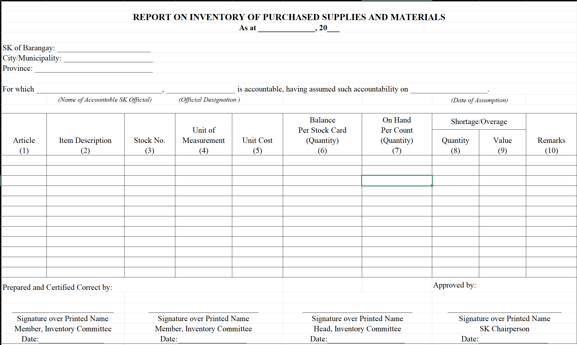

Slide 55
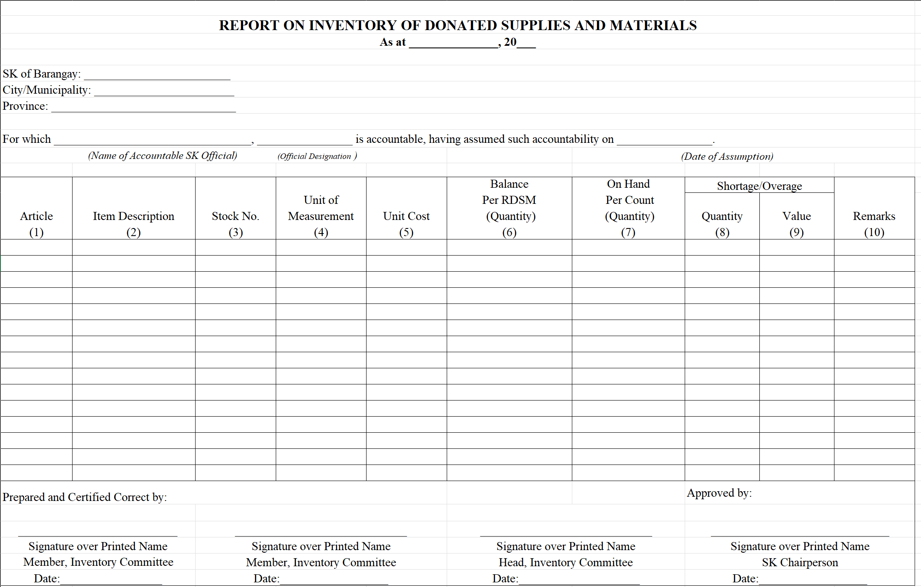

Slide 56
Annual Reports
Report | Prepared by | Submitted to | Deadline
Statement of Receipts and Payments (ASRP) | SK Treasurer | SK, SB and COA Auditor | within 60 days after the end of each year
Statement of Comparison of Budget and Actual Amounts | Budget Monitoring Officer | SK, SB and COA Auditor | within 60 days after the end of each year
Report on Inventory of Purchased Property and Equipment (RIPPE) | SK Treasurer | SK and COA Auditor | Not later than January 31 of the following year
Report on Inventory of Donated Property and Equipment (RIDPE) | SK Treasurer | SK and COA Auditor | Not later than January 31 of the following year
Notes to Financial Statements | SK Treasurer | SK, SB and COA Auditor | within 60 days after the end of each year

Slide 57
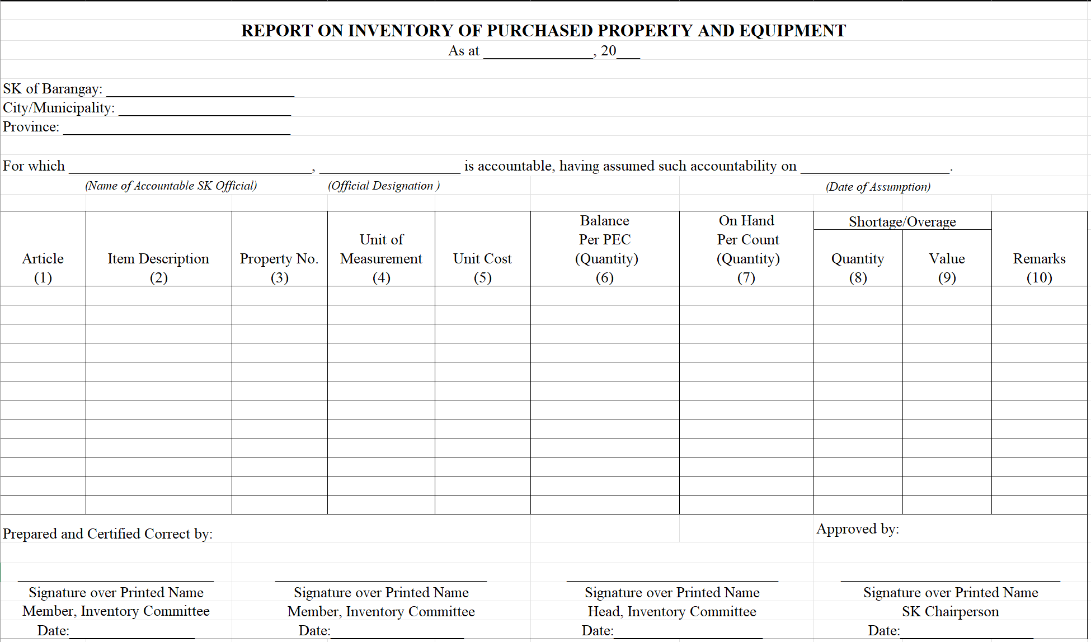

Slide 58
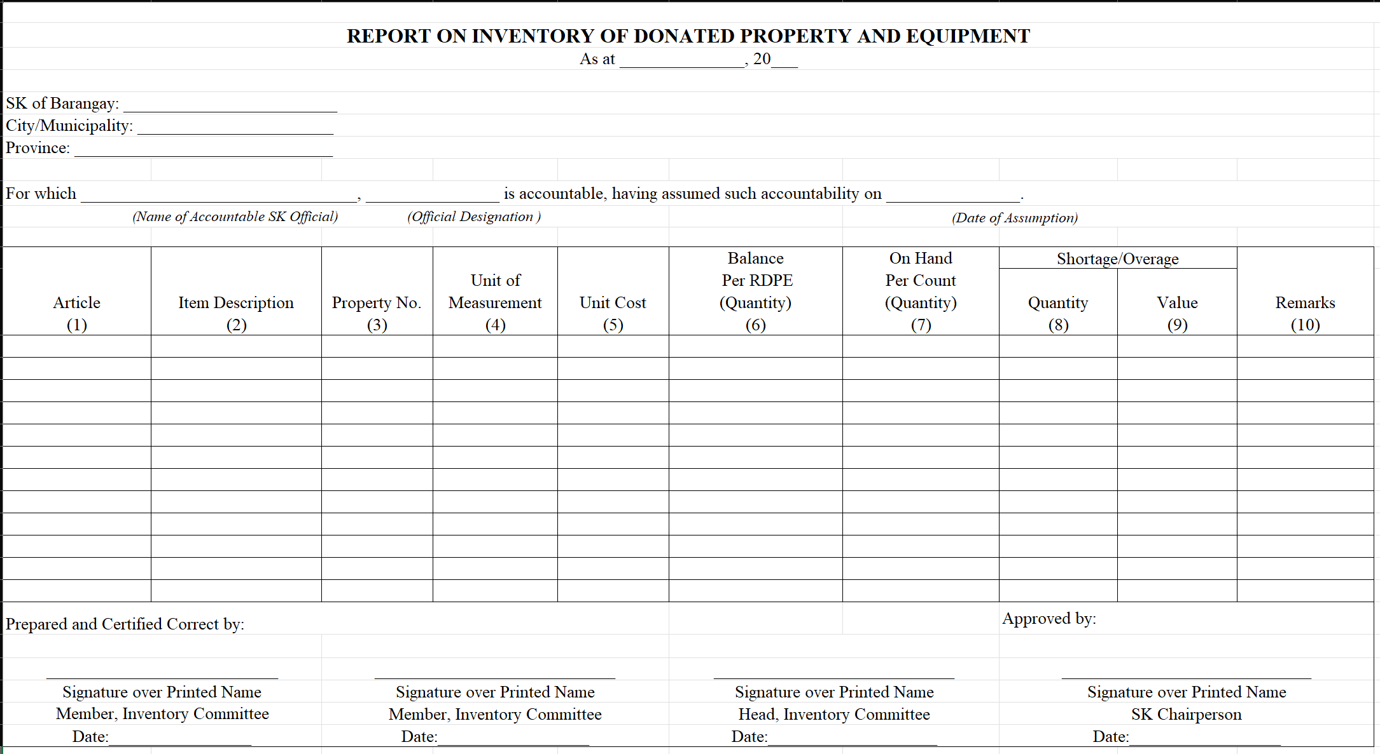

Slide 59






SK TRANSACTION AREAS
Receipts/
Collections
and
Deposits
Disbursements/
Payments
Supplies and Materials
Property and Equipment
Financial Statements Other Reports
Budget
RBCPB
RSPFCPB(if downloaded funds)
RIS/ICS
Stock Card
RIPSM
RIDSM
PAR
Property Card
RIPPE
RIDPE
QSRP
ASRP
SCBAA
SBCPB
Notes to FS
RCRD
RCB
RBCPB
RCB
Notes:
Aside from the Basic Standards and Policies. The HFTSK also provided specific policies per transaction area
Each transaction area will be the topic for each sessions of this training.
The following are the SK transaction areas:
Budget – what consists the SK budget? The handbook provides discussion about the basic and specific policies on the annual budget, the supplemental budget and commitments
Receipts/collections. –How are these recorded in the registries, who records and what reports are prepared.
Disbursements/payments out of the SK funds, and the documents and reports to be accomplished and prepared
Supplies and Materials”, the handbook provides for the procedures on the custody/safekeeping, issuance of purchased and donated supplies and materials
Property and Equipment – the handbook provides for the guidelines in the custody/safekeeping and disposal of Property and Equipment
Financial Statements and Reports to be prepared, the frequency of submission and to whom submitted

Slide 60
Budget
Annual Budget/ Supplemental Budget
Funds Received for Specific Purpose
Commitments
Disbursement/
Payment
Documents/ Basis
SK Resolution and Copy of the Approved Budget
SK Resolution and Copy of OR
PO/Contract/DV
Paid DV/SDs
Registry
Registry of Budget, Commitments, Payments and Balances (RBCPB)
Registry of Specific Purpose Fund, Commitments, Payments and Balances (RSPFCPB)
FS and Other Reports
Summary of Budget, Commitments, Payments and Balances (SBCPB)
Summary of Specific Purpose Fund, Commitments, Payments and Balances (SSPFCPB)
Statement of Comparison of Budget and Actual Amounts (SCBAA)

Slide 61
Collections and Deposits
COLLECTIONS
DEPOSITS
Documents/Basis
ORs/VDSs/CMs/SDs
VDSs/SDs
Records/Registry/ Register
Register of Cash Receipts, Deposits and Other Related Financial Transactions (RCRD)
Register of Cash in Bank and Other Related Financial Transactions (RCB)
FS and Other Reports
Statement of Receipts and Payments (SRP)
Notes to Financial Statements
Bank Reconciliation Statement

Slide 62
Disbursements/Payments
CHECKS
CASH ADVANCES
Documents/ Basis
DVs/Checks/SDs
DVs/Checks/LR/SDs
Registry/ Register
RBCPB/RSPFCPB
Register of Cash in Bank and Other Related Financial Transactions (RCB)
FS and Other Reports
SCBAA/SBCPB/ SSPFCPB
Statement of Receipts and Payments (SRP)
Notes to Financial Statements
Bank Reconciliation Statement

Slide 63
RECEIPT/ISSUE/DISPOSITION OF PROPERTY AND EQUIPMENT/SUPPLIES AND MATERIALS
Documents/Basis
PO, PR, IAR, ARDPE/SM,
RIS, ICS, PAR ISDPE/SM
Records/Registry/ Register
PEC/SC (for purchased item)
RDSM/RDPE (for donated item)
FS and Other Reports
RIPSM, RIDSM, RIPPE and RIDPE

Slide 64
Sample Transactions
Transaction | SK Transaction Area | Registry | Report
The SK of Barangay Gairan, Bogo City through SK Resolution No. 005, series of 2023, has approved the SK Annual Budget for CY 2024 | Budget | RBCPB | SBCPB SCBAA

Slide 65
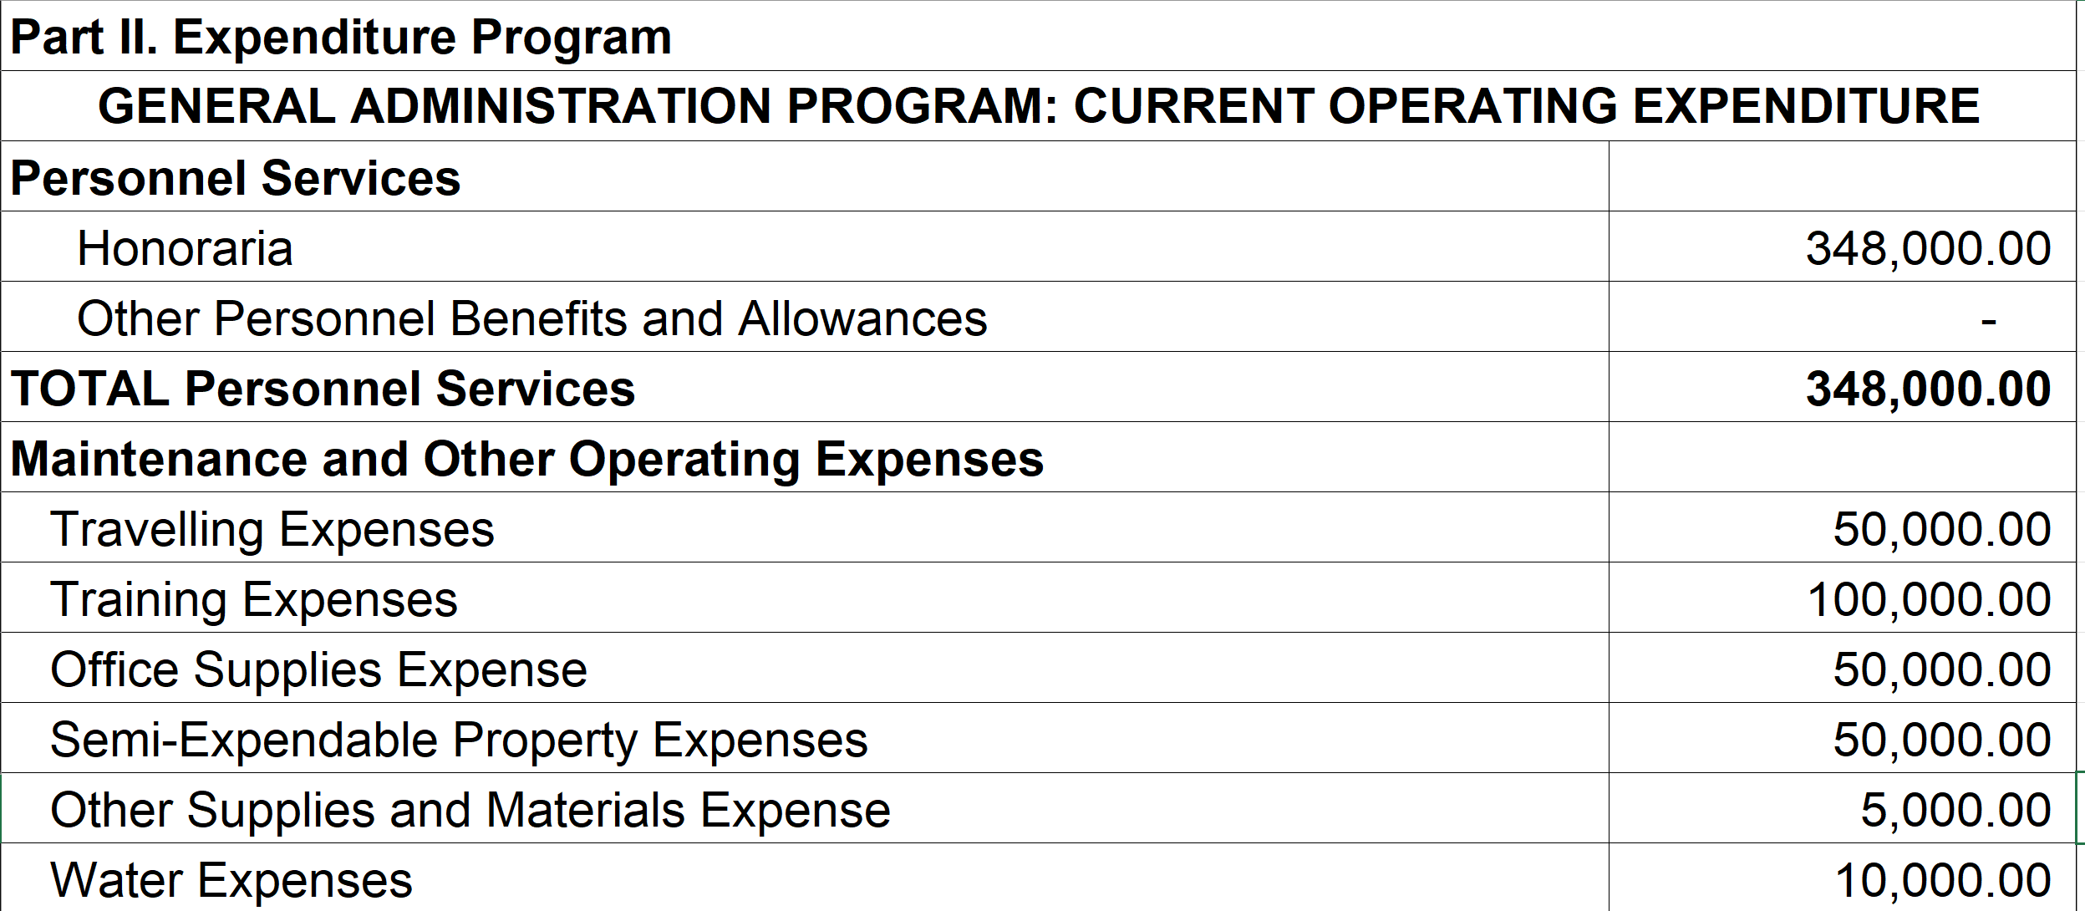
Sample Transactions
Transaction : | The SK of Barangay Gairan, Bogo City through SK Resolution No. 005, series of 2023, has approved the SK Annual Budget for CY 2024

Slide 66
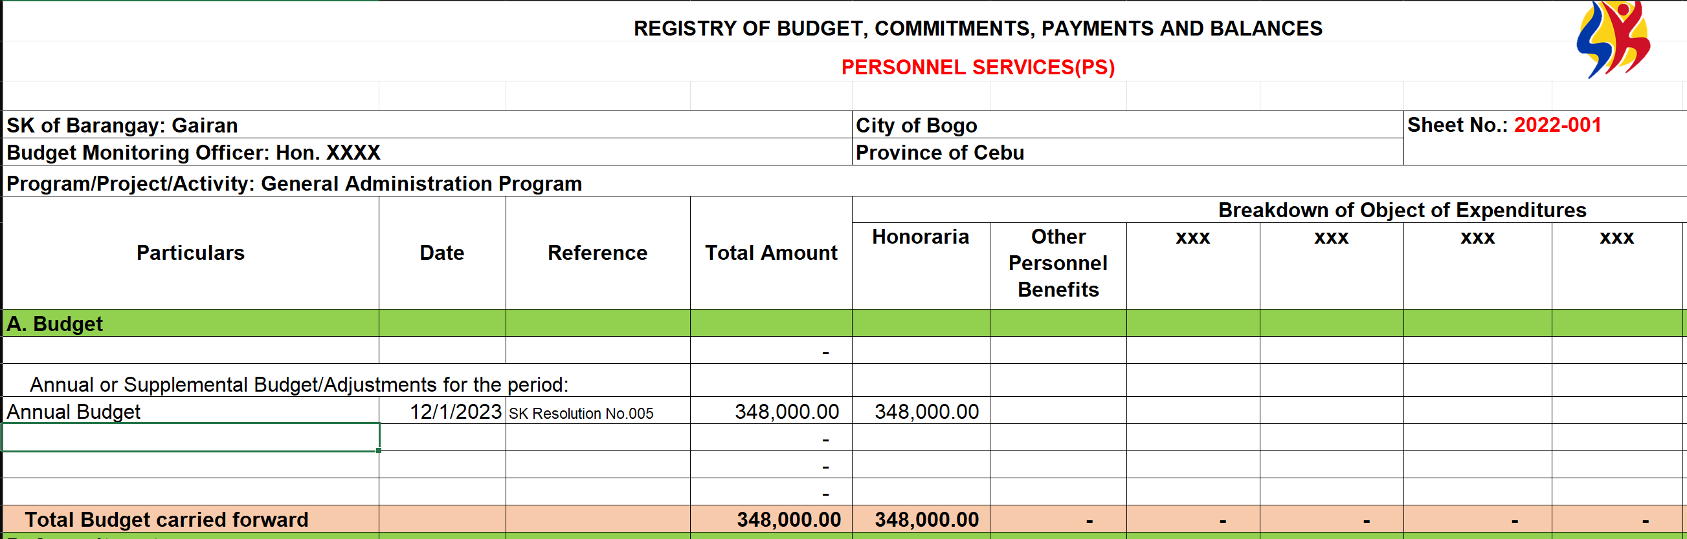
How recorded in the RBCPB?
Transaction : | The SK of Barangay Gairan, Bogo City through SK Resolution No. 005, series of 2023, has approved the SK Annual Budget for CY 2024

Slide 67
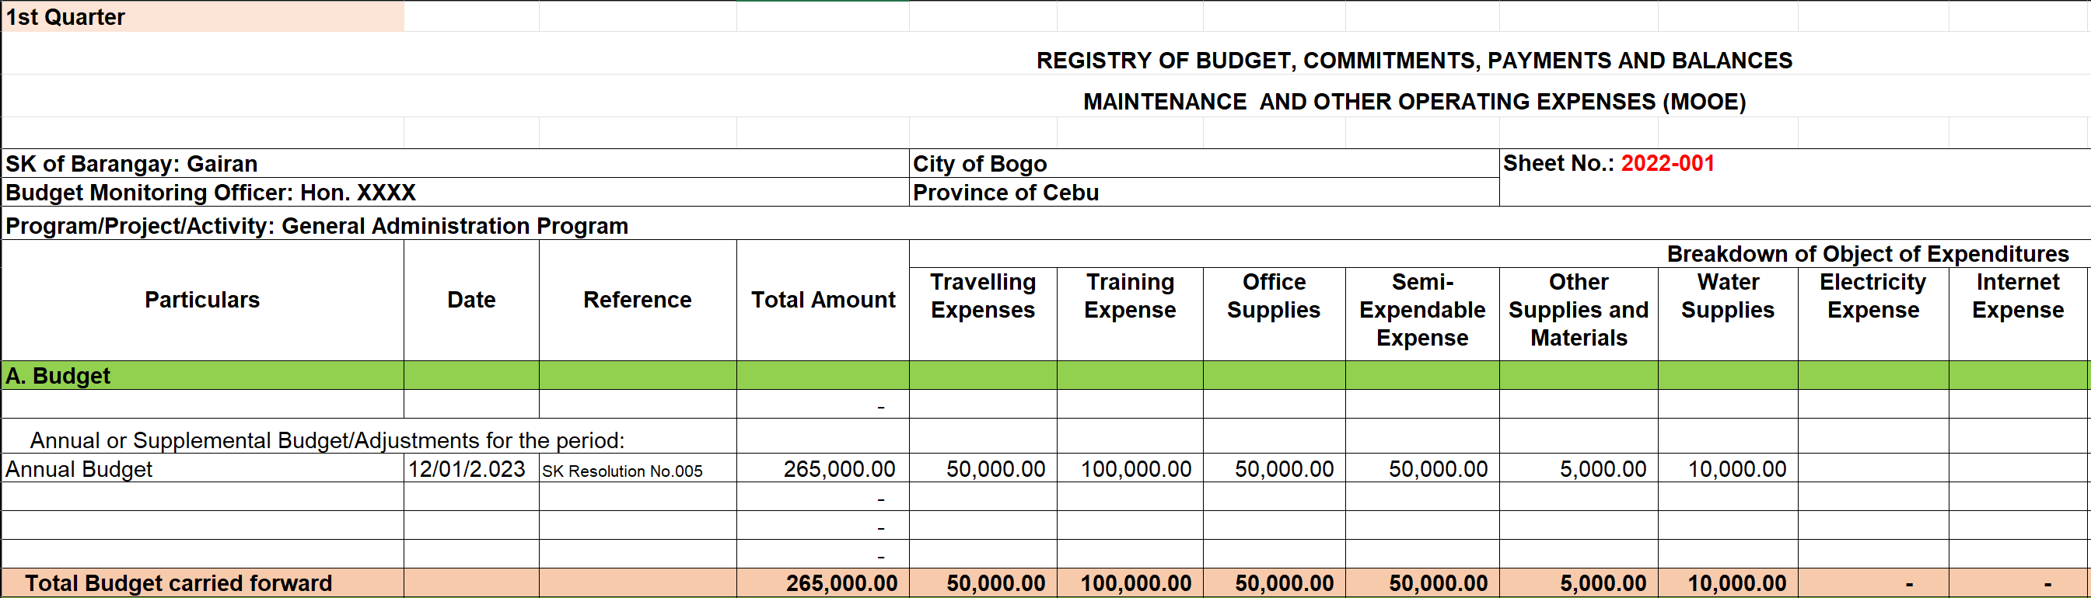
How recorded in the RBCPB?
Transaction : | The SK of Barangay Gairan, Bogo City through SK Resolution No. 005, series of 2023, has approved the SK Annual Budget for CY 2024

Slide 68
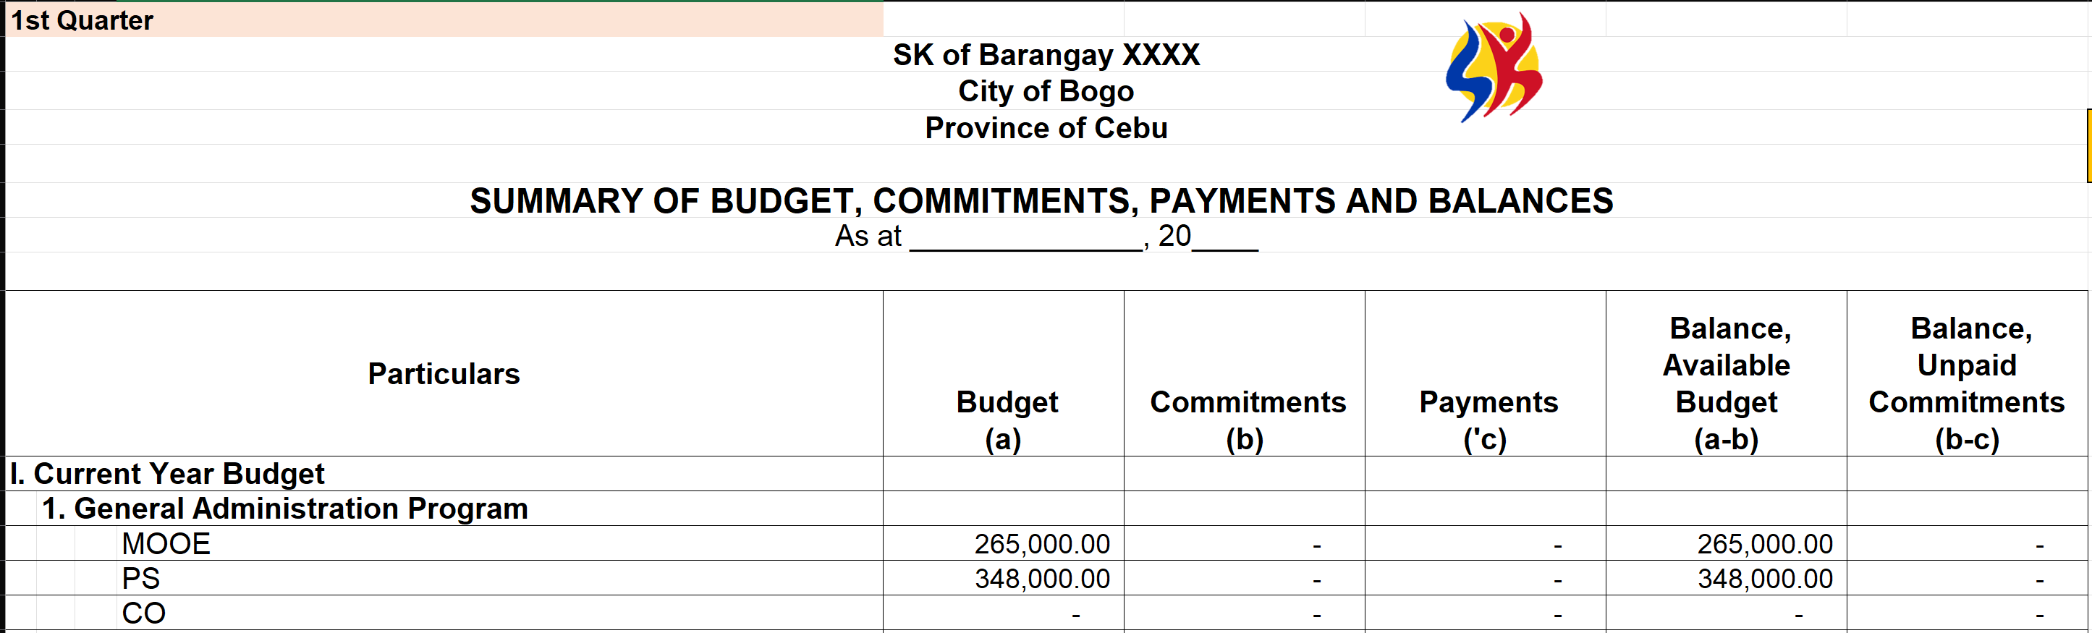
How reported in SBCPB?
Transaction : | The SK of Barangay Gairan, Bogo City through SK Resolution No. 005, series of 2023, has approved the SK Annual Budget for CY 2024

Slide 69
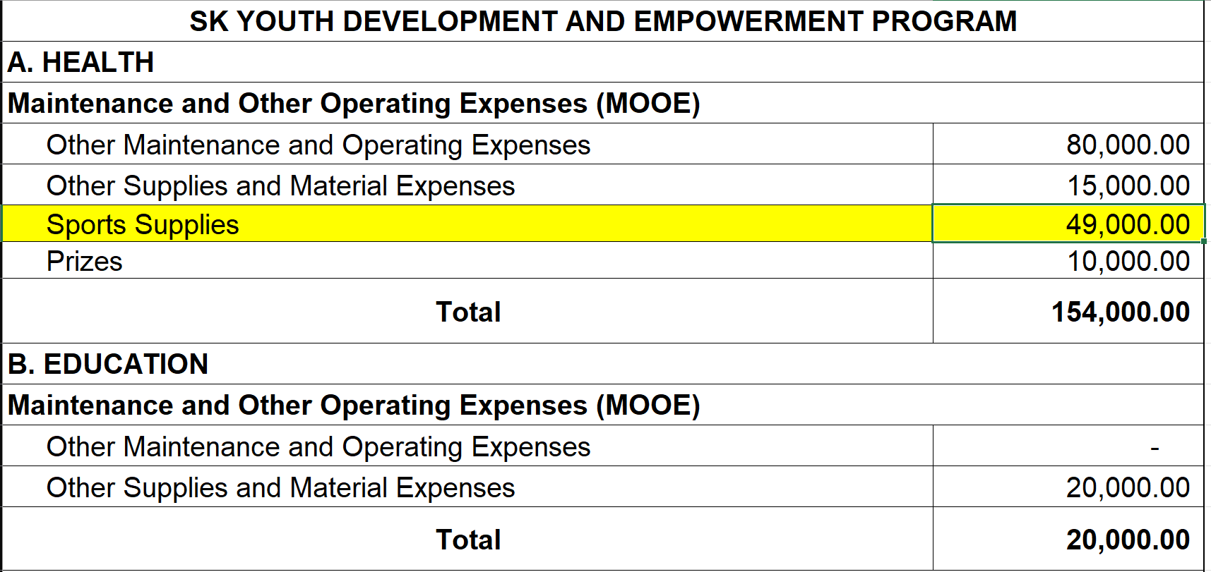
Sample Transactions
Transaction : | The SK of Barangay Gairan, Bogo City through SK Resolution No. 005, series of 2023, has approved the SK Annual Budget for CY 2024

Slide 70
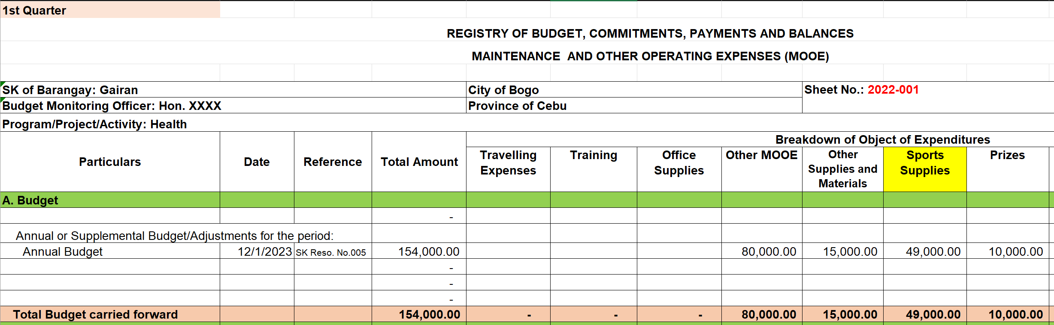
How recorded in the RBCPB?
Transaction : | The SK of Barangay Gairan, Bogo City through SK Resolution No. 005, series of 2023, has approved the SK Annual Budget for CY 2024

Slide 71
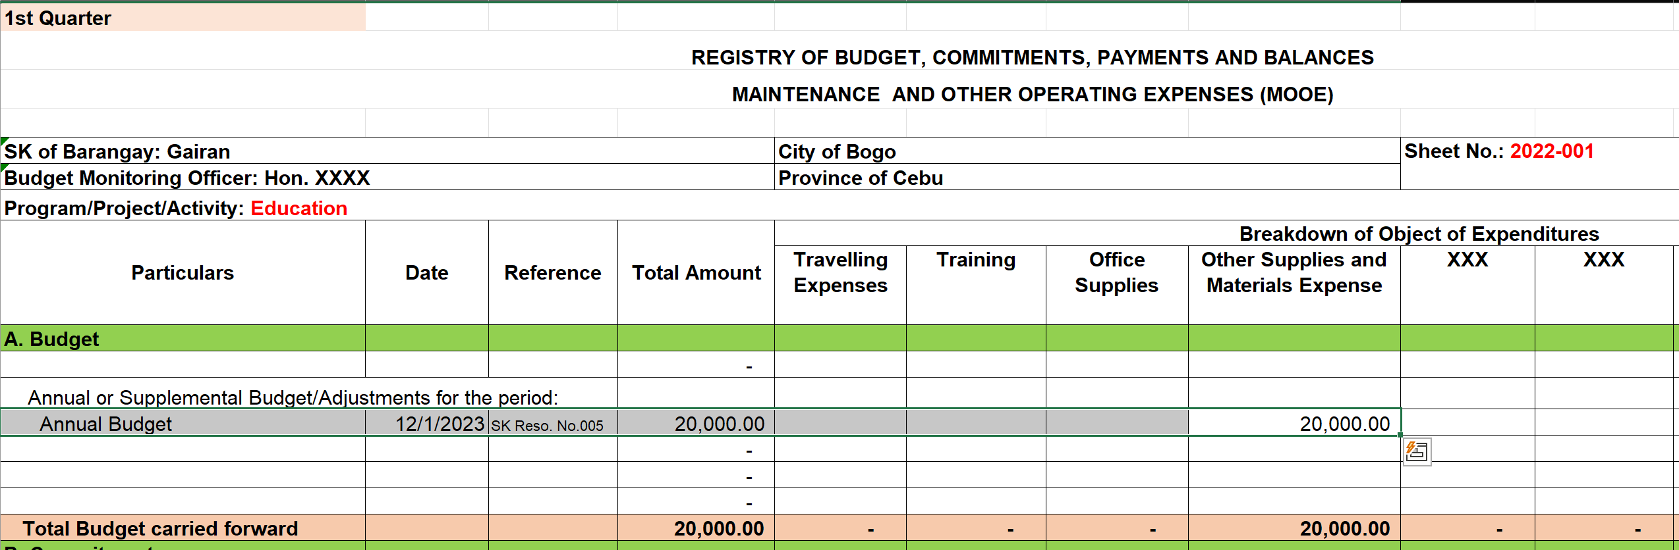
How recorded in the RBCPB?
Transaction : | The SK of Barangay Gairan, Bogo City through SK Resolution No. 005, series of 2023, has approved the SK Annual Budget for CY 2024

Slide 72
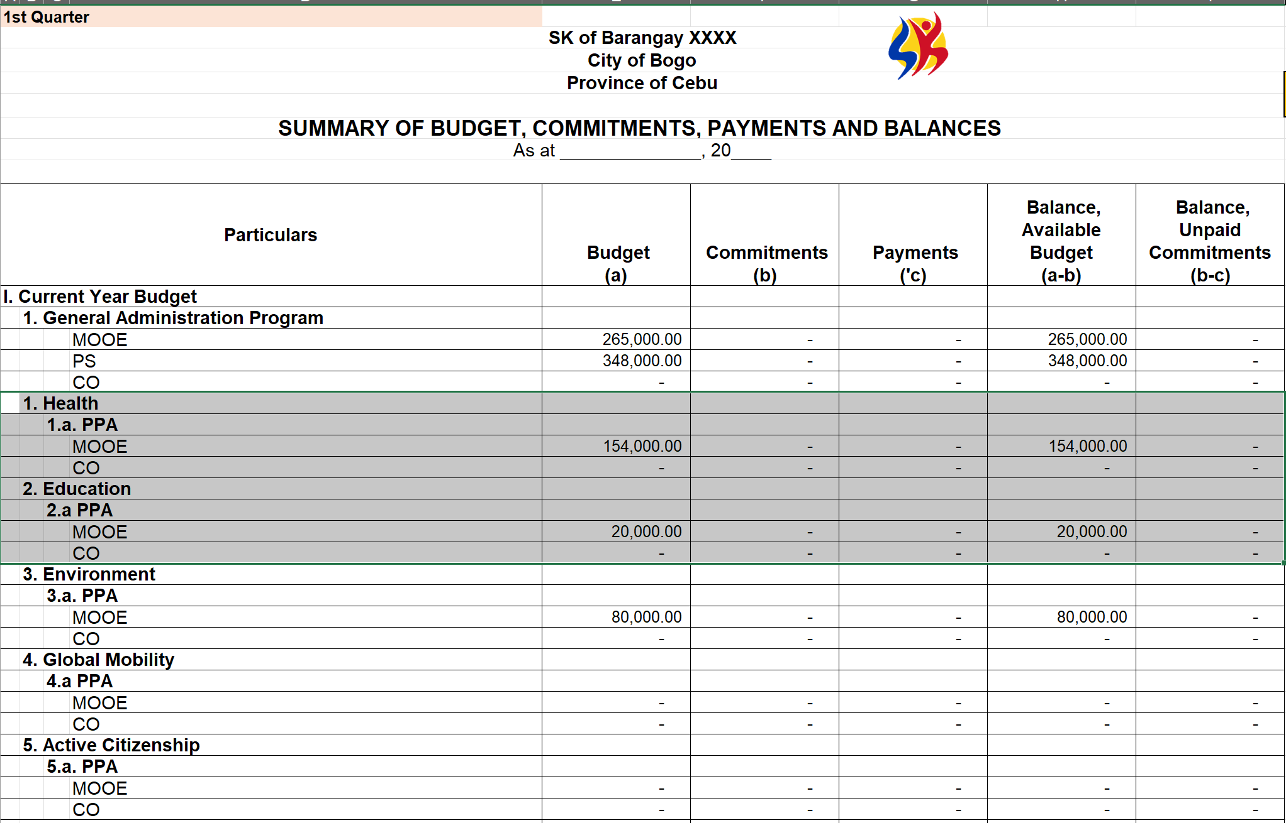
How reported in SBCPB?
Transaction : | The SK of Barangay Gairan, Bogo City through SK Resolution No. 005, series of 2023, has approved the SK Annual Budget for CY 2024

Slide 73
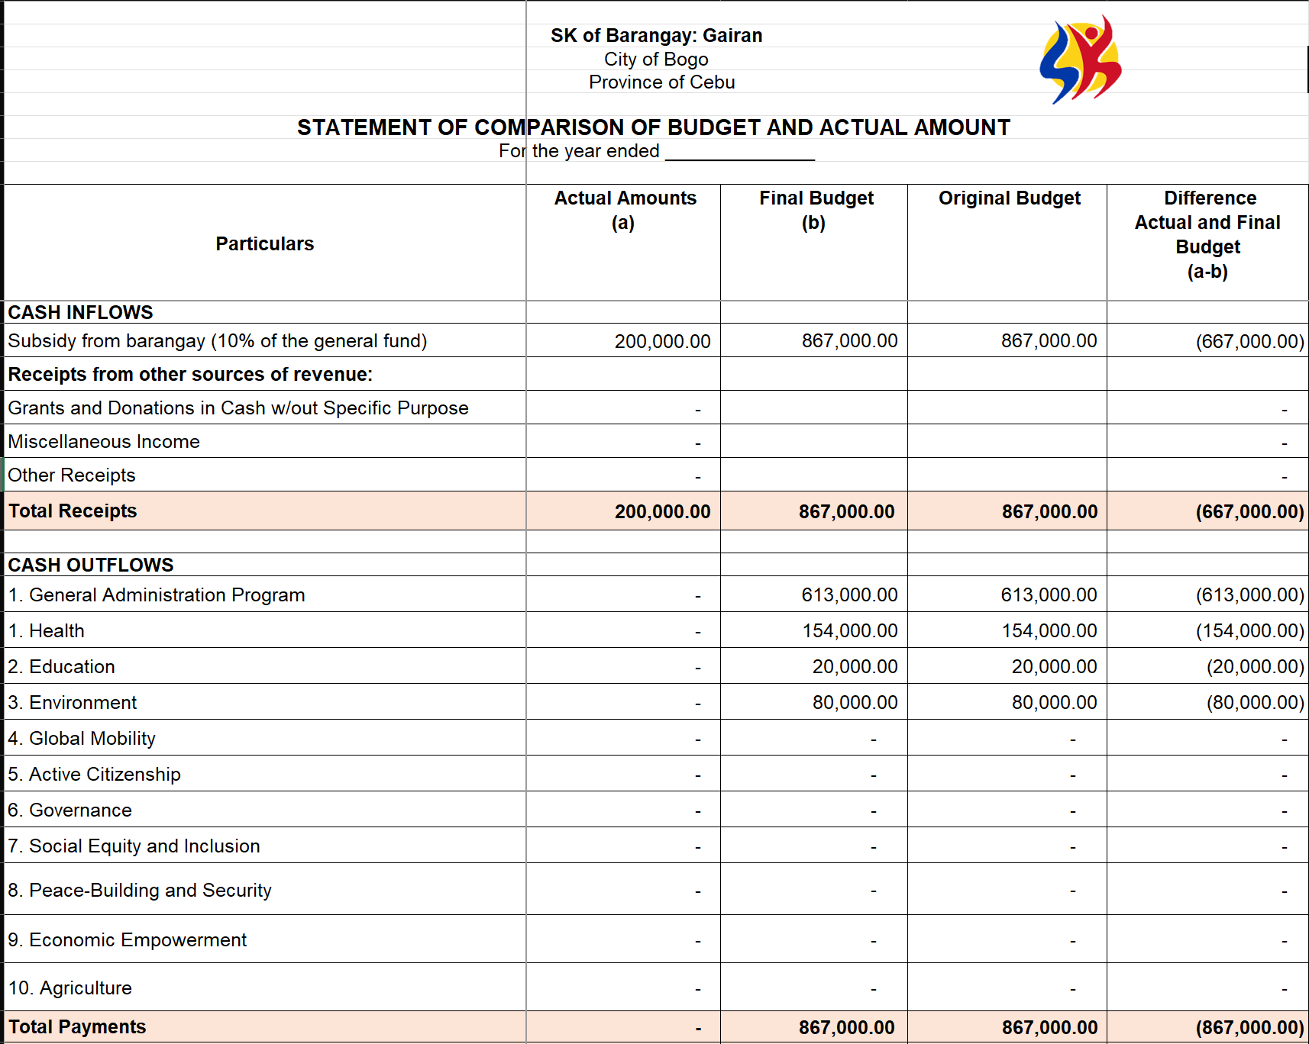
How reported in SCBAA?
Transaction : | The SK of Barangay Gairan, Bogo City through SK Resolution No. 005, series of 2023, has approved the SK Annual Budget for CY 2024

Slide 74
Sample Transactions
Transaction | SK Transaction Area | Registry | Report
Received the 10% SK for the month of January 2024 per OR No. 001 | Deposit | RCRD | QSRP/ASRP SCBAA

Slide 75
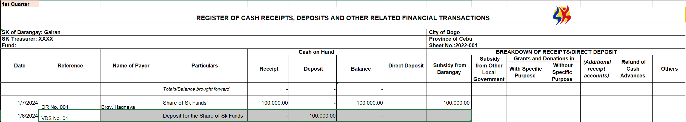
How recorded in the RCRD?
Transaction : | Received the 10% SK for the month of January 2024 per OR No. 001

Slide 76
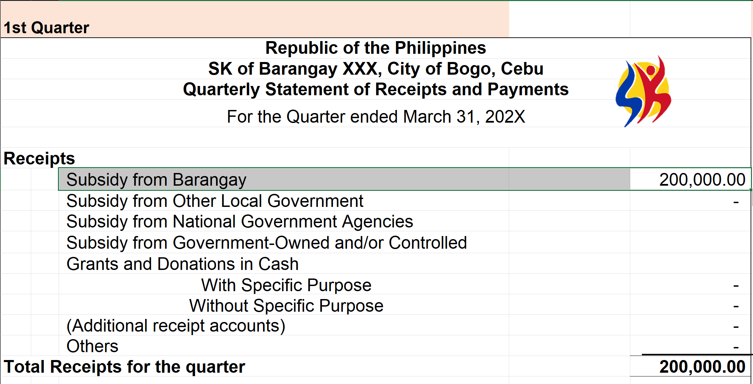
How reported in QSRP?
Transaction : | Received the 10% SK for the month of January 2024 per OR No. 001

Slide 77
How reported in SCBAA?
Transaction : | The SK of Barangay Gairan, Bogo City through SK Resolution No. 005, series of 2023, has approved the SK Annual Budget for CY 2024

Slide 78
Sample Transactions
Transaction | SK Transaction Area | Registry | Report
Deposited the amount received as 10% SK share to Land Bank of the Philippines (LBP) | Receipts/ Collection | RCRD RCB | QSRP/ASRP

Slide 79
How recorded in the RCRD?
Transaction : | Deposited the amount received as 10% SK share to Land Bank of the Philippines (LBP)

Slide 80
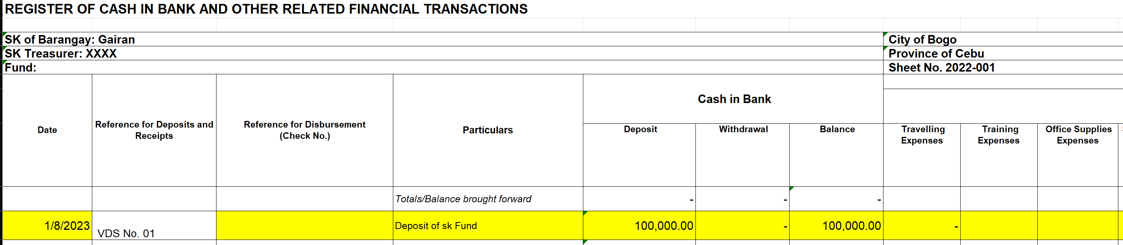
How recorded in the RCB?
Transaction : | Deposited the amount received as 10% SK share to Land Bank of the Philippines (LBP)

Slide 81
Sample Transactions
Transaction | SK Transaction Area | Recorded in: | Reported in:
Paid fidelity bond to Bureau of Treasury in the amount of P5,000.00 | Disbursement | RBCPB RCB | QSRP/ASRP SBCPB SCBAA

Slide 82
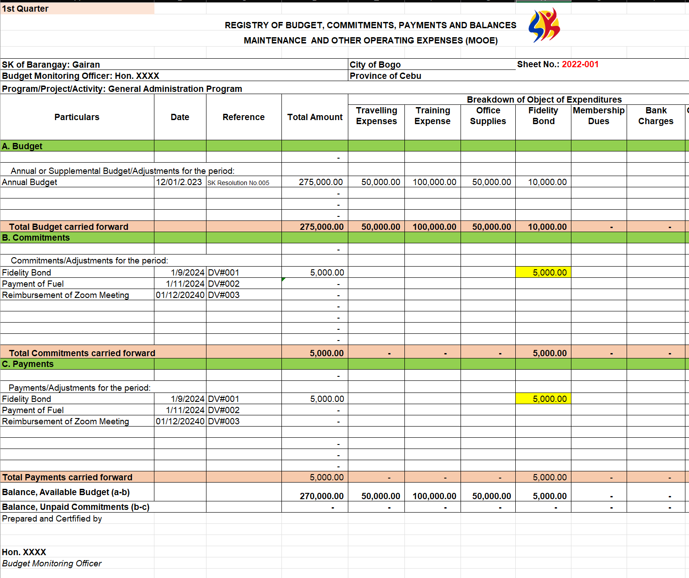
How recorded in the RBCPB?
Transaction : | Paid fidelity bond to Bureau of Treasury in the amount of P5,000.00

Slide 83
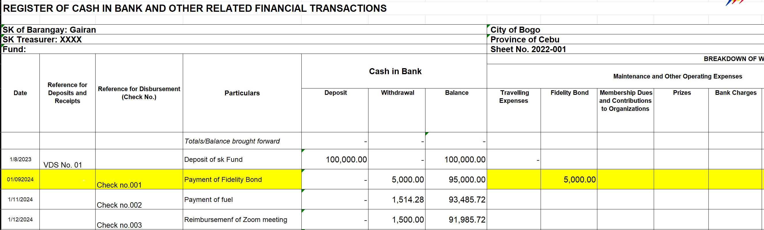
How recorded in the RCB?
Transaction : | Paid fidelity bond to Bureau of Treasury in the amount of P5,000.00

Slide 84
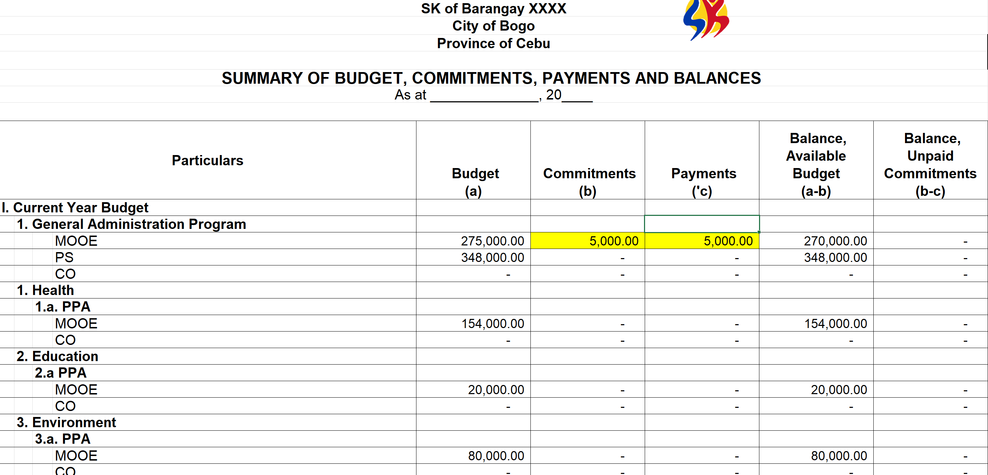
How reported in SBCPB?
Transaction : | Paid fidelity bond to Bureau of Treasury in the amount of P5,000.00

Slide 85
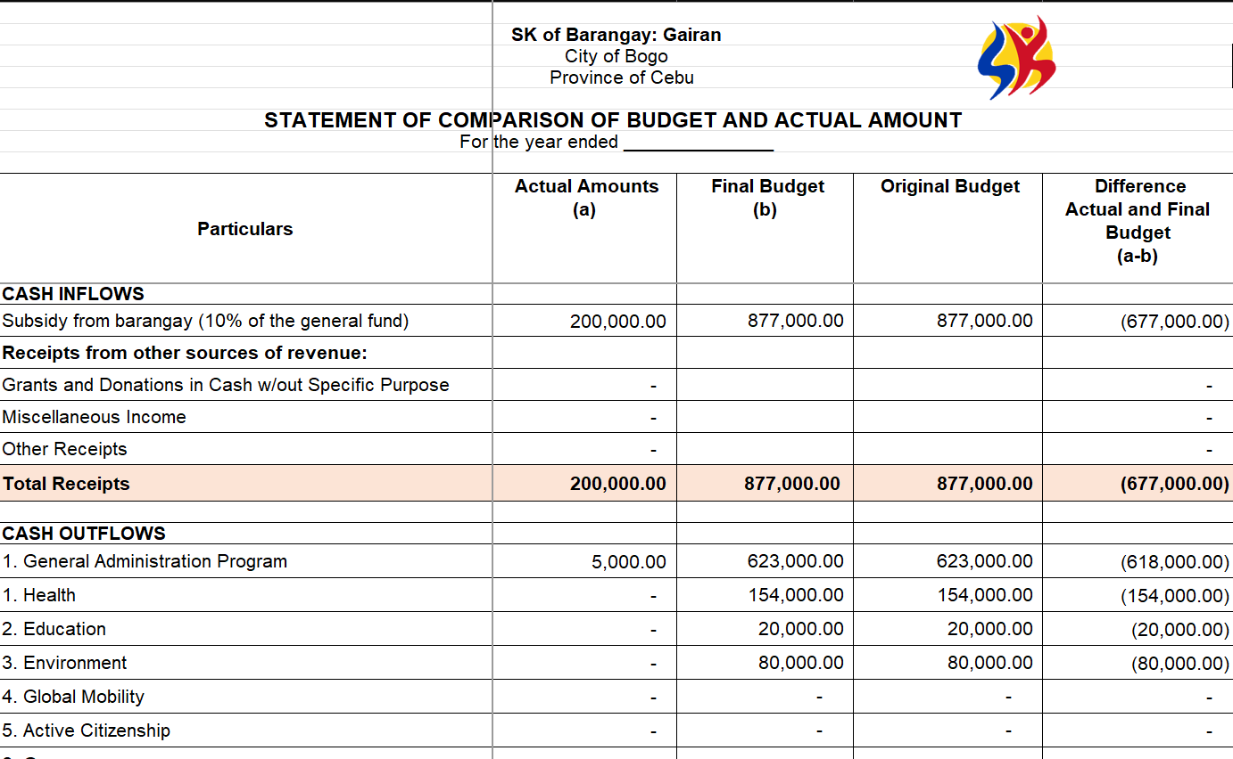
How reported in SCBAA?
Transaction : | Paid fidelity bond to Bureau of Treasury in the amount of P5,000.00

Slide 86
Sample Transactions
Transaction | SK Transaction Area | Recorded in: | Reported in:
Cash advance of SK Treasurer for the monthly honoraria of SK Officials with an amount of P1,000 per official. (9 officials) | Disbursement | RBCPB RCB | QSRP/ASRP SBCPB SCBAA

Slide 87
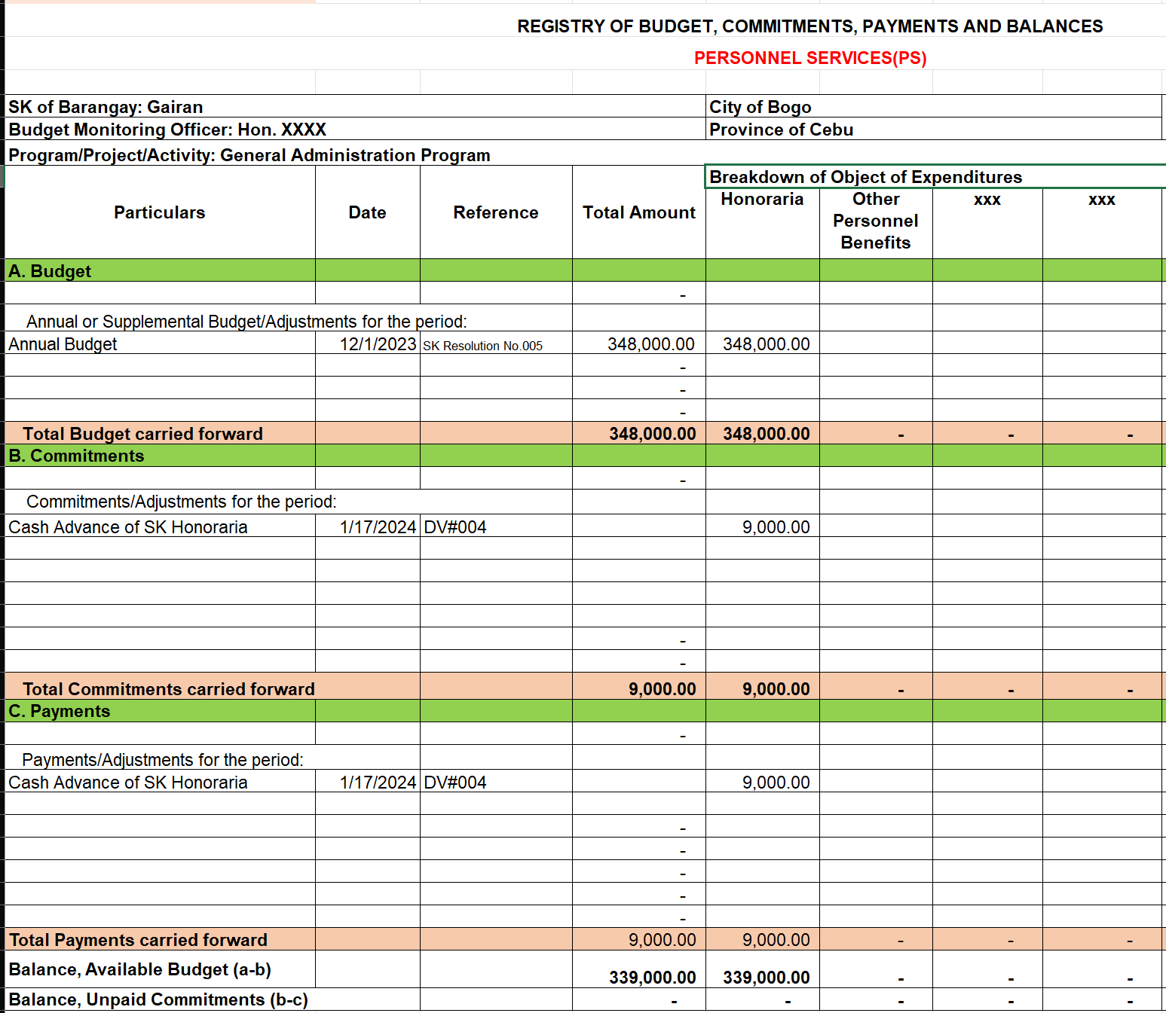
How recorded in the RBCPB?
Transaction : | Cash advance of SK Treasurer for the monthly honoraria of SK Officials with an amount of P1,000 per official. (9 officials)

Slide 88
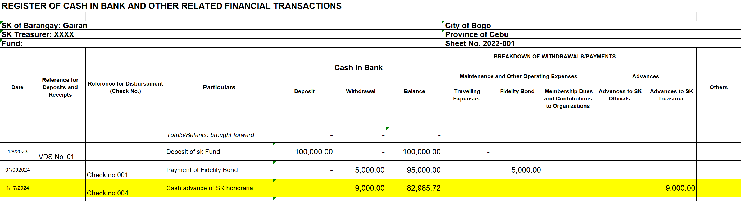
How recorded in the RCB?
Transaction : | Cash advance of SK Treasurer for the monthly honoraria of SK Officials with an amount of P1,000 per official. (9 officials)

Slide 89
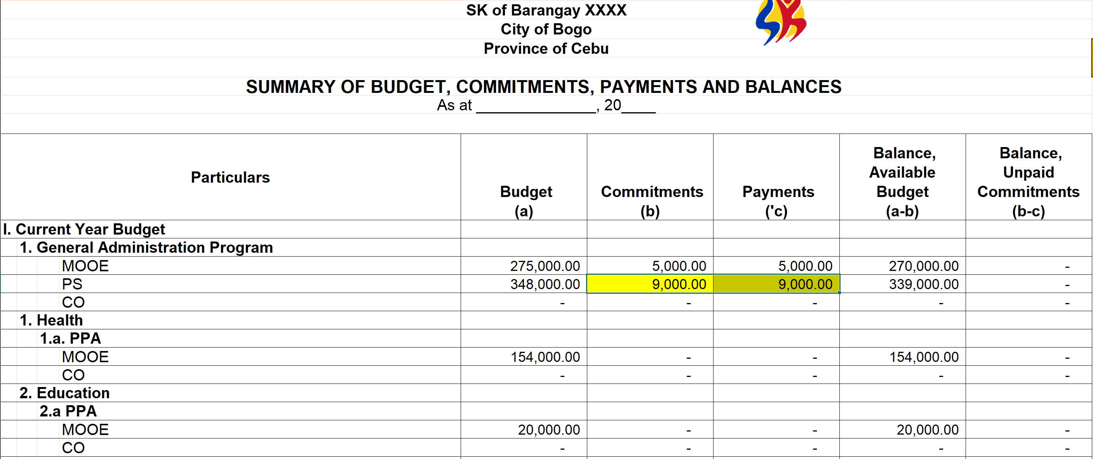
How reported in SBCPB?
Transaction : | Cash advance of SK Treasurer for the monthly honoraria of SK Officials with an amount of P1,000 per official. (9 officials)

Slide 90
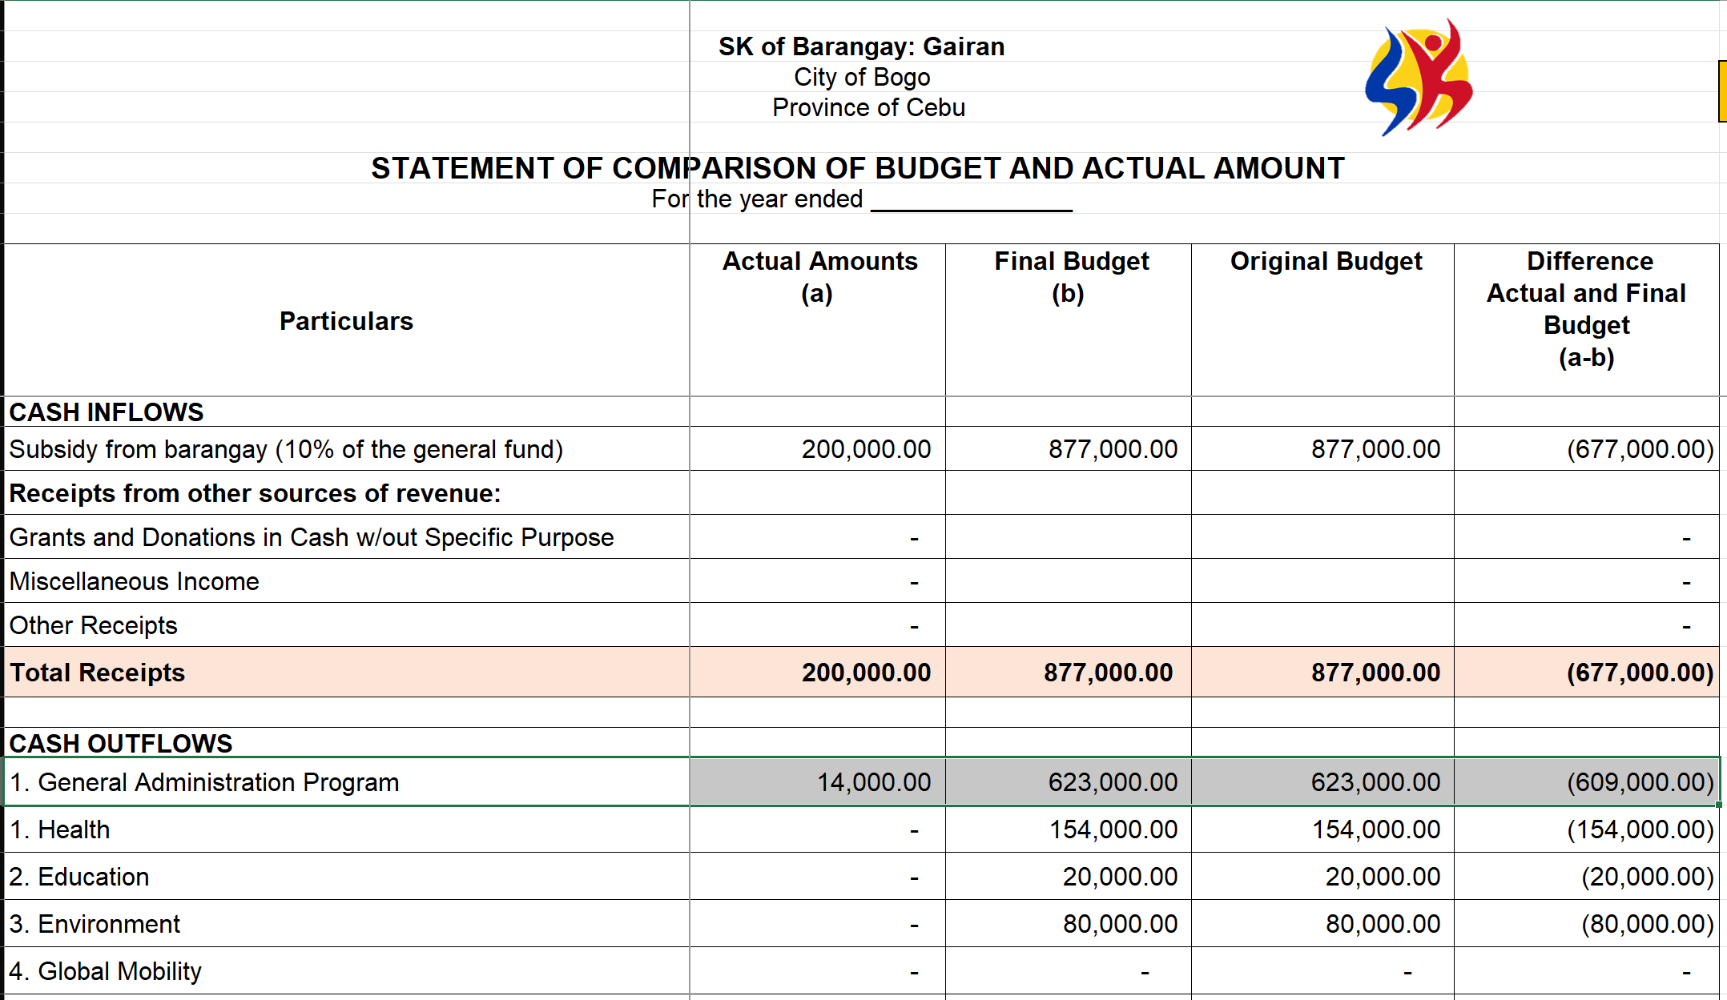
How reported in SCBAA?
Transaction : | Cash advance of SK Treasurer for the monthly honoraria of SK Officials with an amount of P1,000 per official. (9 officials)

Slide 91
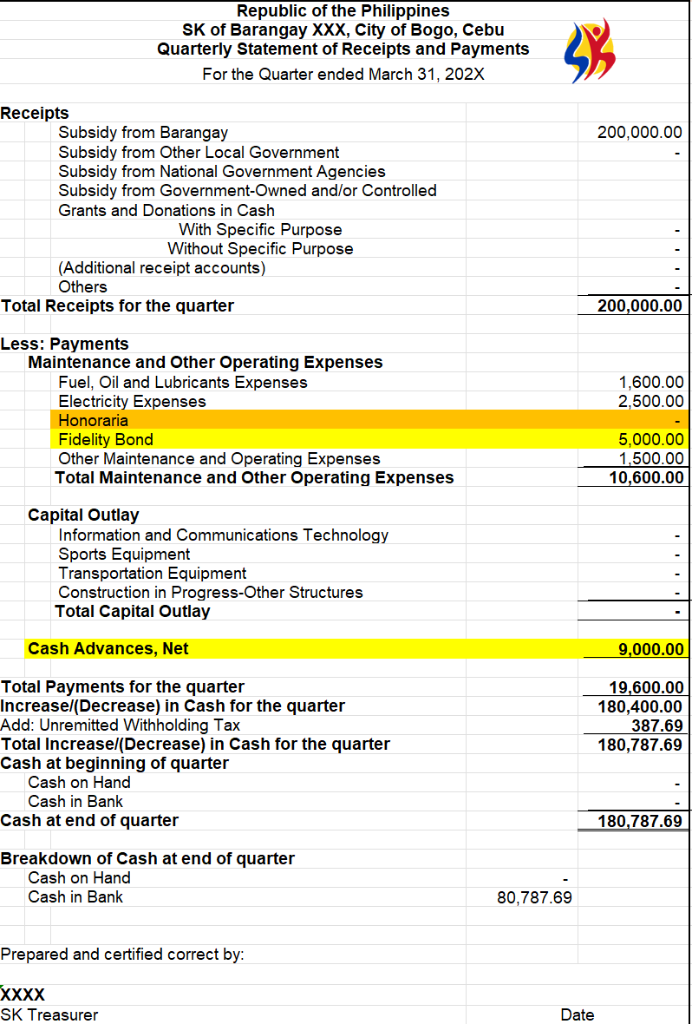
How reported in QSRP?
Transaction : | Cash advance of SK Treasurer for the monthly honoraria of SK Officials with an amount of P1,000 per official. (9 officials)

Slide 92
Sample Transactions
Transaction | SK Transaction Area | Recorded in: | Reported in:
Liquidation of Cash Advance of the SK Treasurer for the monthly honoraria. (Actual Amount Spent is P9,000.00) | Disbursement | RBCPB RCB | QSRP/ASRP SBCPB SCBAA

Slide 93
How recorded in the RBCPB?
Transaction : | Liquidation of Cash Advance of the SK Treasurer for the monthly honoraria. (Actual Amount Spent is P9,000.00)
 | NO LONGER RECORDED IN THE RBCPB

Slide 94
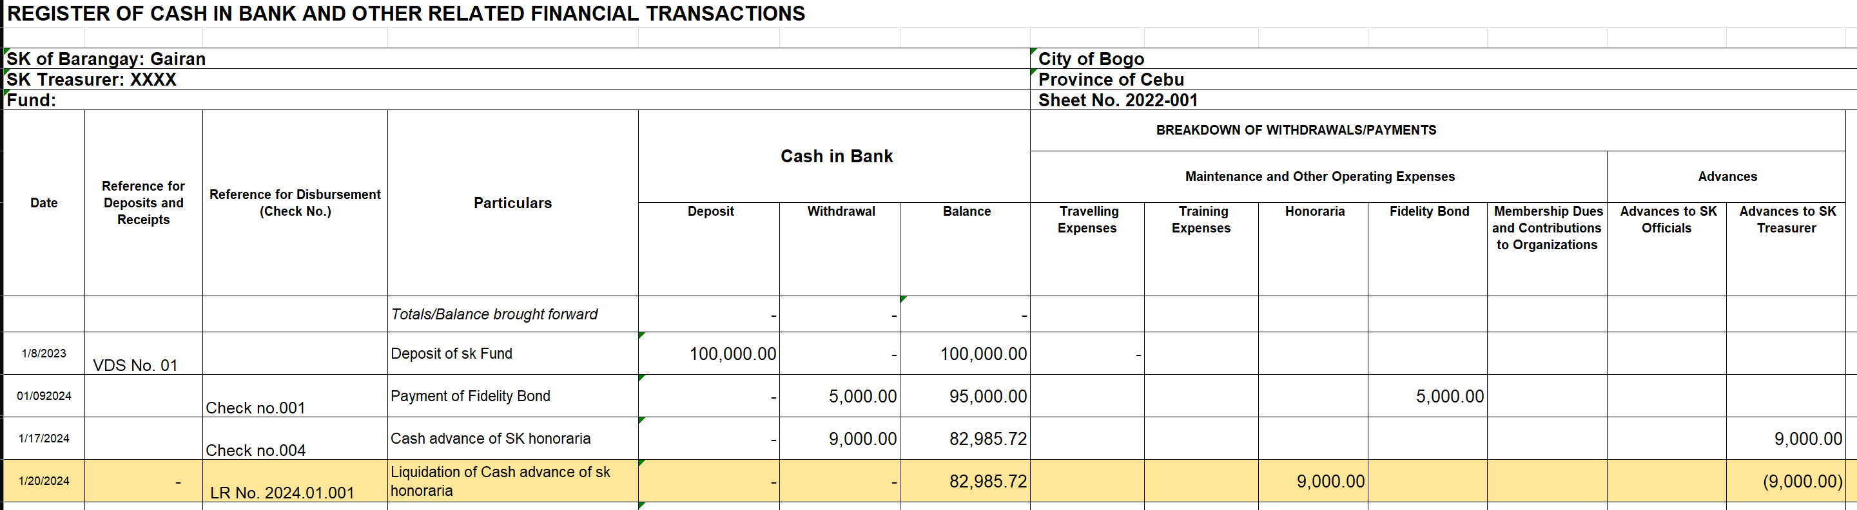
How recorded in the RCB?
Transaction : | Liquidation of Cash Advance of the SK Treasurer for the monthly honoraria. (Actual Amount Spent is P9,000.00)

Slide 95
How reported in SBCPB?
Transaction : | Liquidation of Cash Advance of the SK Treasurer for the monthly honoraria. (Actual Amount Spent is P9,000.00)
 | NO EFFECT IN SBCPB

Slide 96
How reported in SCBAA?
Transaction : | Liquidation of Cash Advance of the SK Treasurer for the monthly honoraria. (Actual Amount Spent is P9,000.00)
 | NO EFFECT IN SCBAA

Slide 97
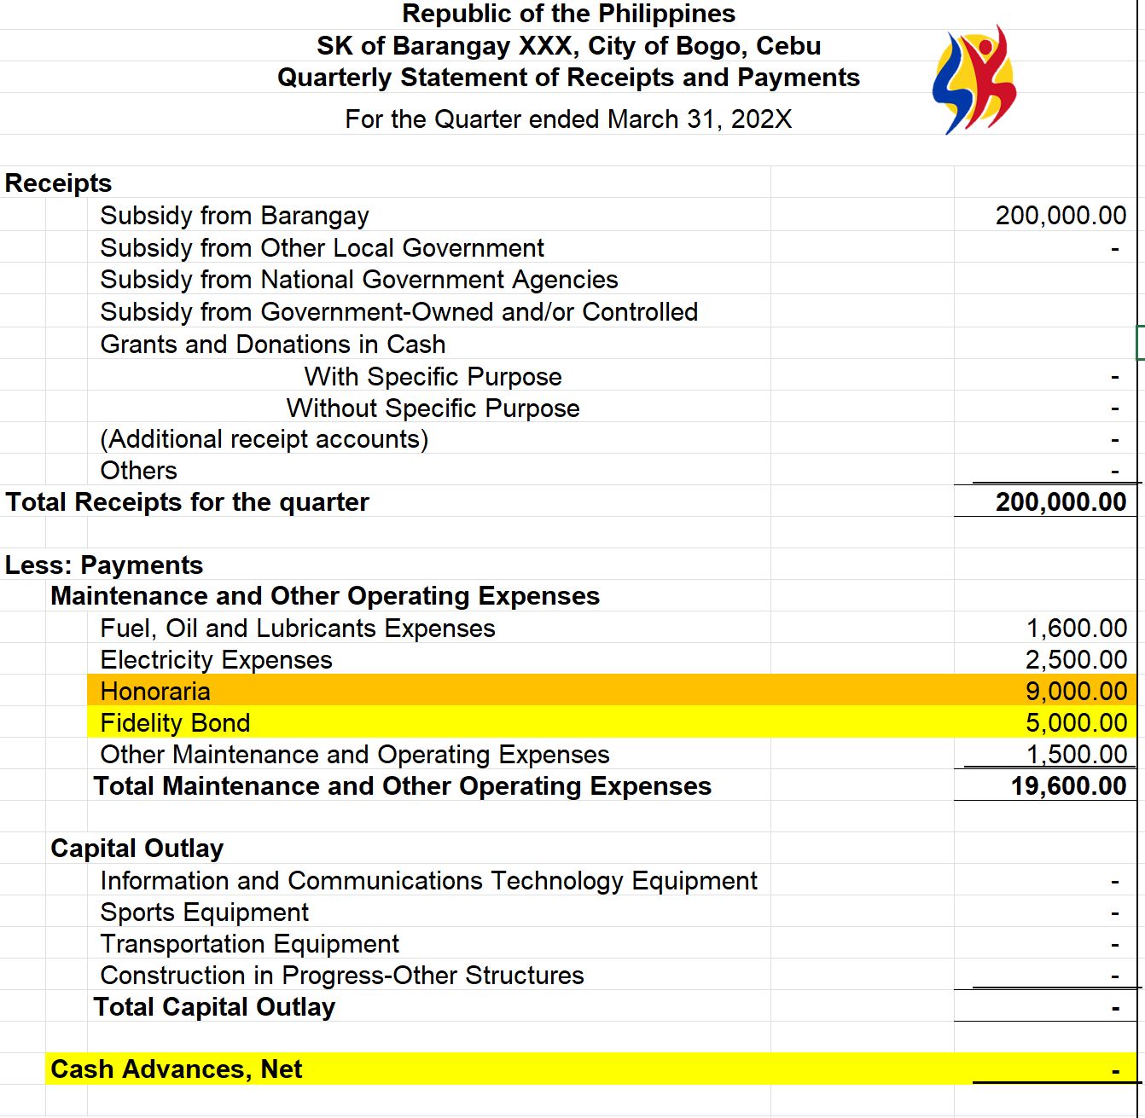
How reported in QSRP?
Transaction : | Liquidation of Cash Advance of the SK Treasurer for the monthly honoraria. (Actual Amount Spent is P9,000.00)

Slide 98
Sample Transactions
Transaction | SK Transaction Area | Recorded in: | Reported in:
Liquidation of Cash Advance for the monthly honoraria. (But the Actual Amount Spent is only P8,000.00) Issued Official Receipt to the refund of P1,000.00 Deposited the amount of P1,000 | Disbursement Collection | RBCPB RCB RCRD RCRD RCB | QSRP/ASRP SBCPB SCBAA

Slide 99
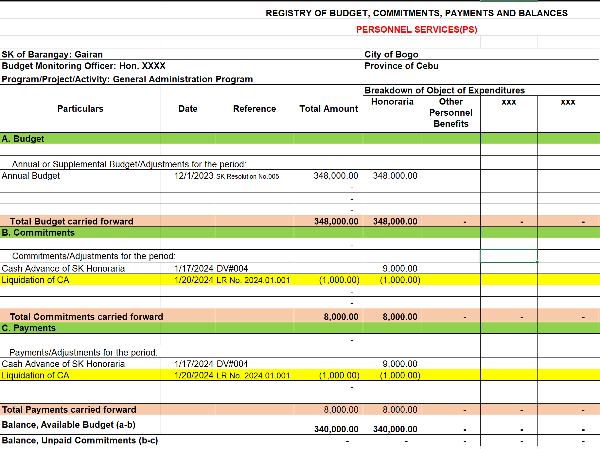
How recorded in the RBCPB?
Transaction : | Liquidation of Cash Advance of the SK Treasurer for the monthly honoraria. (Actual Amount Spent is P8,000.00)

Slide 100
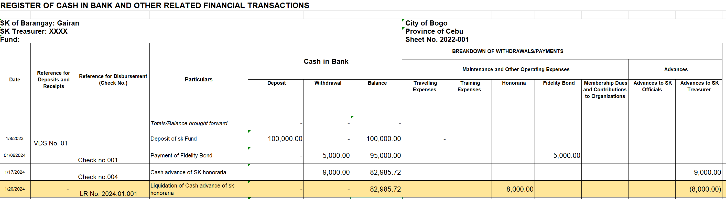
How recorded in the RCB?
Transaction : | Liquidation of Cash Advance of the SK Treasurer for the monthly honoraria. (Actual Amount Spent is P8,000.00)

Slide 101
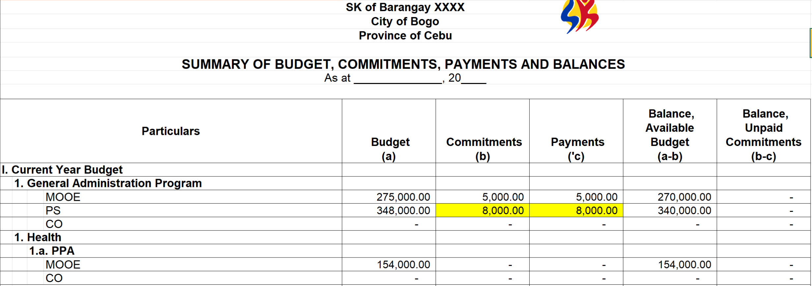
How reported in SBCPB?
Transaction : | Liquidation of Cash Advance of the SK Treasurer for the monthly honoraria. (Actual Amount Spent is P8,000.00)

Slide 102
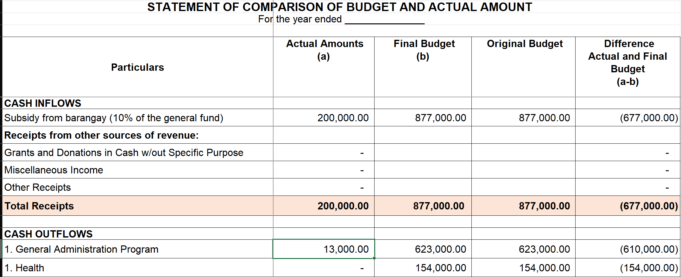
How reported in SCBAA?
Transaction : | Liquidation of Cash Advance of the SK Treasurer for the monthly honoraria. (Actual Amount Spent is P8,000.00)

Slide 103
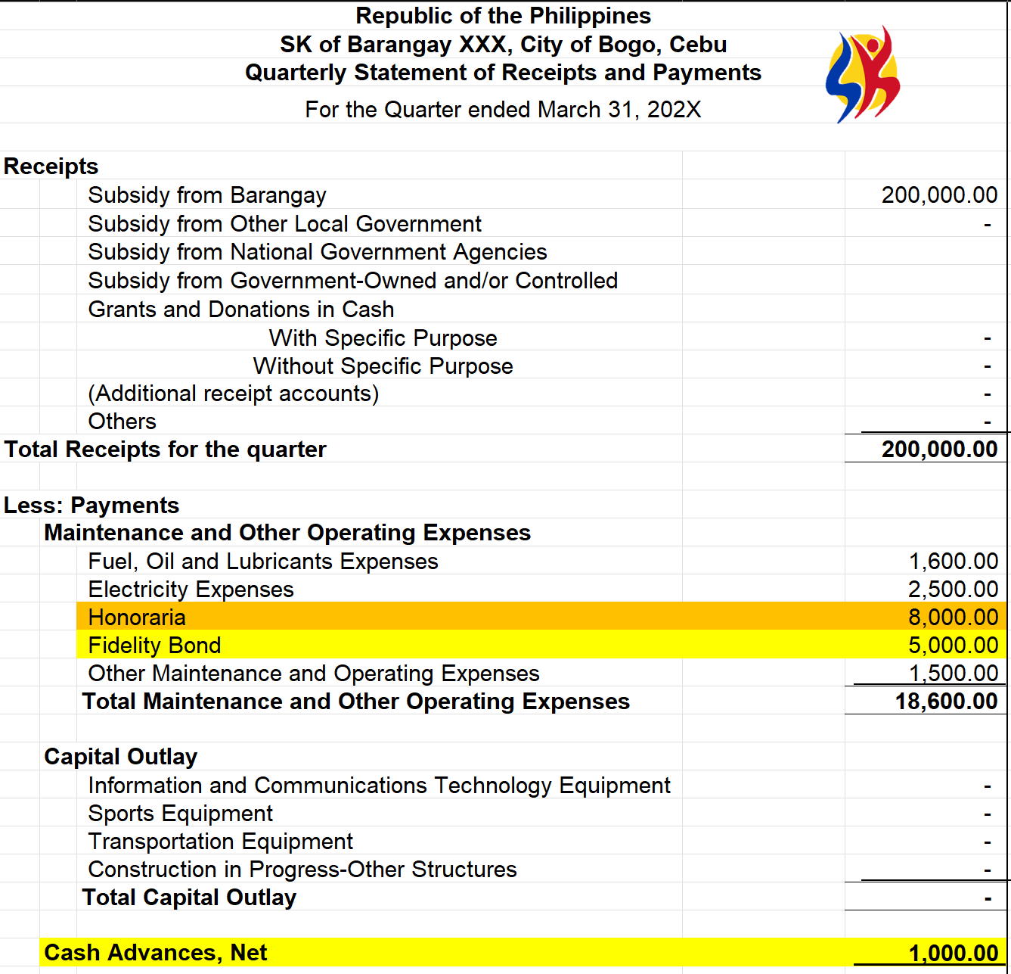
How reported in QSRP?
Transaction : | Liquidation of Cash Advance of the SK Treasurer for the monthly honoraria. (Actual Amount Spent is P8,000.00)

Slide 104
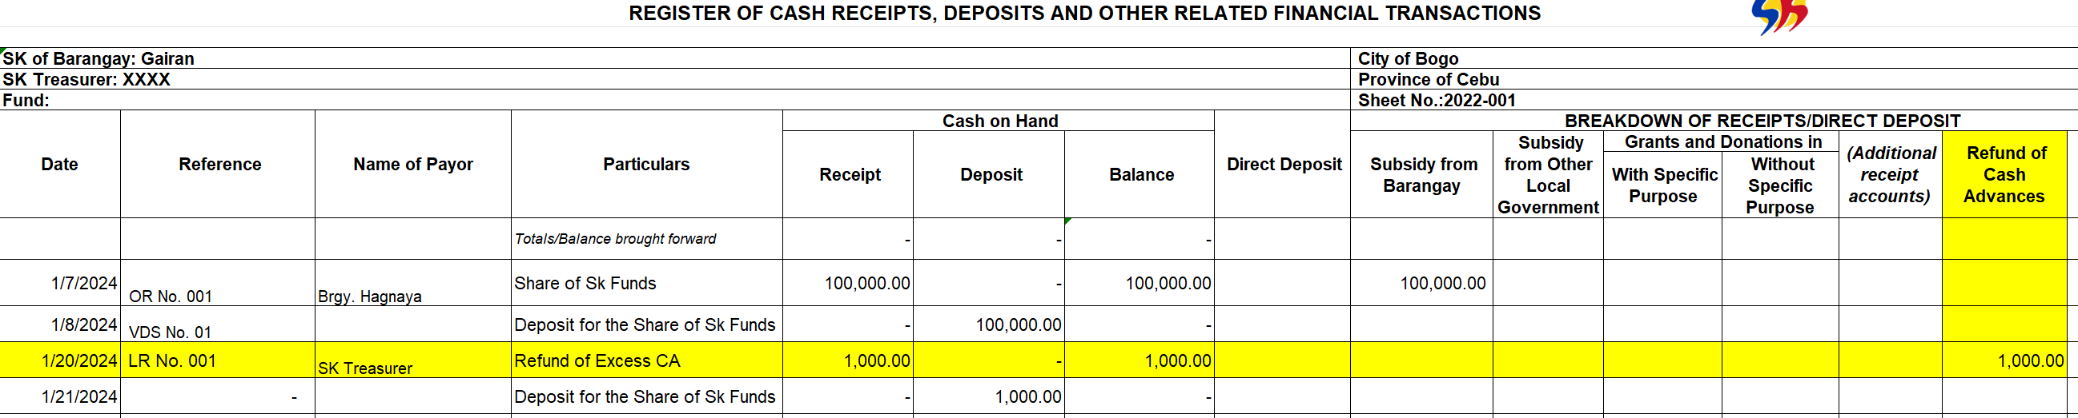
How reported in RCRD?
Transaction : | Liquidation of Cash Advance of the SK Treasurer for the monthly honoraria. (Actual Amount Spent is P8,000.00) Issued Official Receipt to the refund of P1,000.00

Slide 105
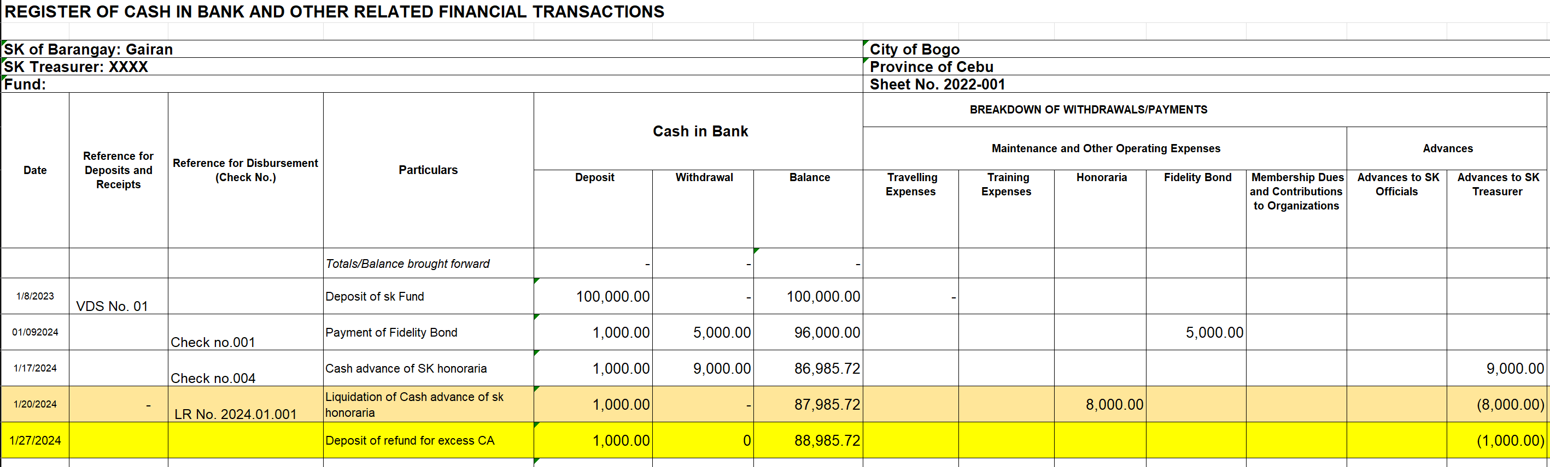
How reported in RCB?
Transaction : | Liquidation of Cash Advance of the SK Treasurer for the monthly honoraria. (Actual Amount Spent is P8,000.00) Issued Official Receipt to the refund of P1,000.00 (NOT RECORDED IN THE RCB) Deposited the amount of P1,000.

Slide 106
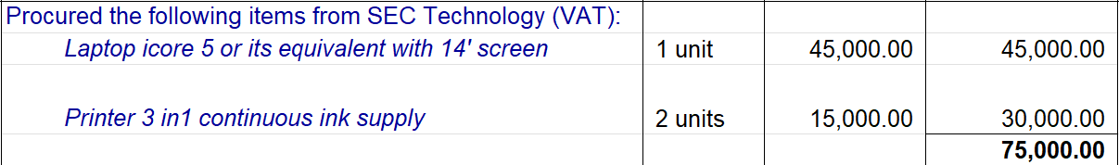
Sample Transactions
Transaction | SK Transaction Area | Recorded in: | Reported in:
VAT: (75,000/1.12) x 5% = 3,348.21 EWT:(75,000/1.12)x1% = 669.64 Net Amount Due =P70,982.15 | Disbursement | RBCPB RCB | QSRP/ASRP SBCPB SCBAA

Slide 107
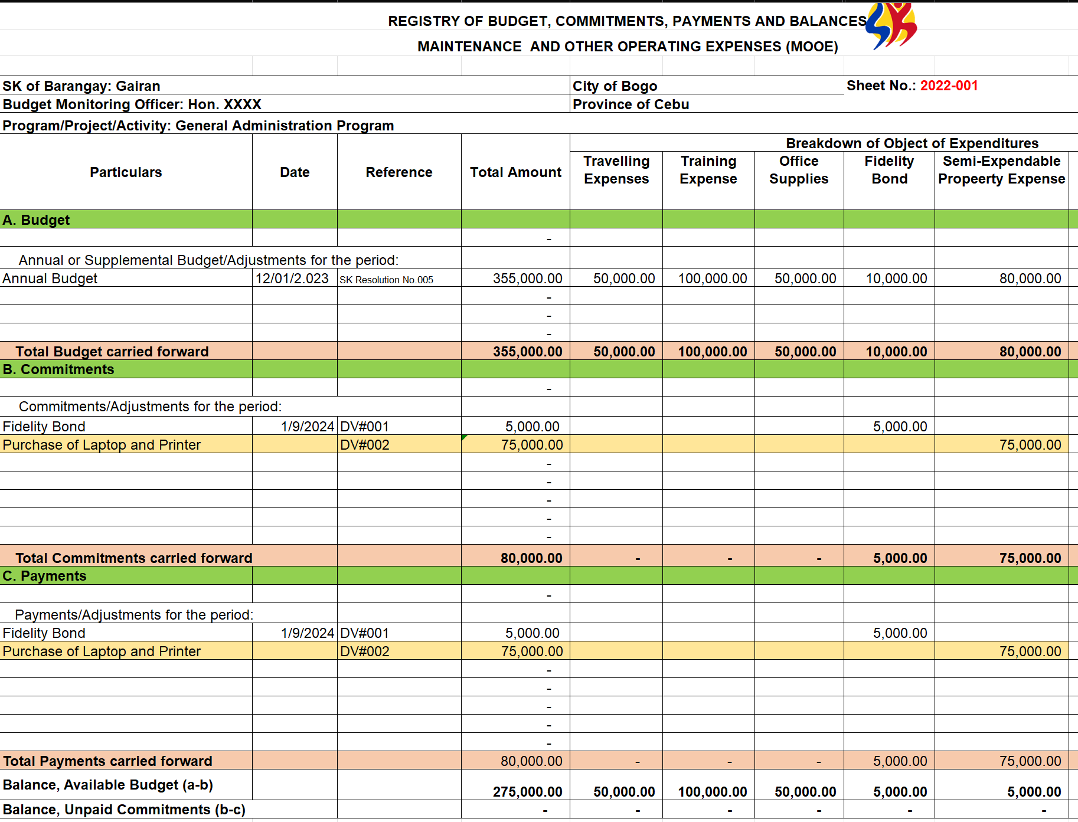
How recorded in the RBCPB?
My version:

Slide 108
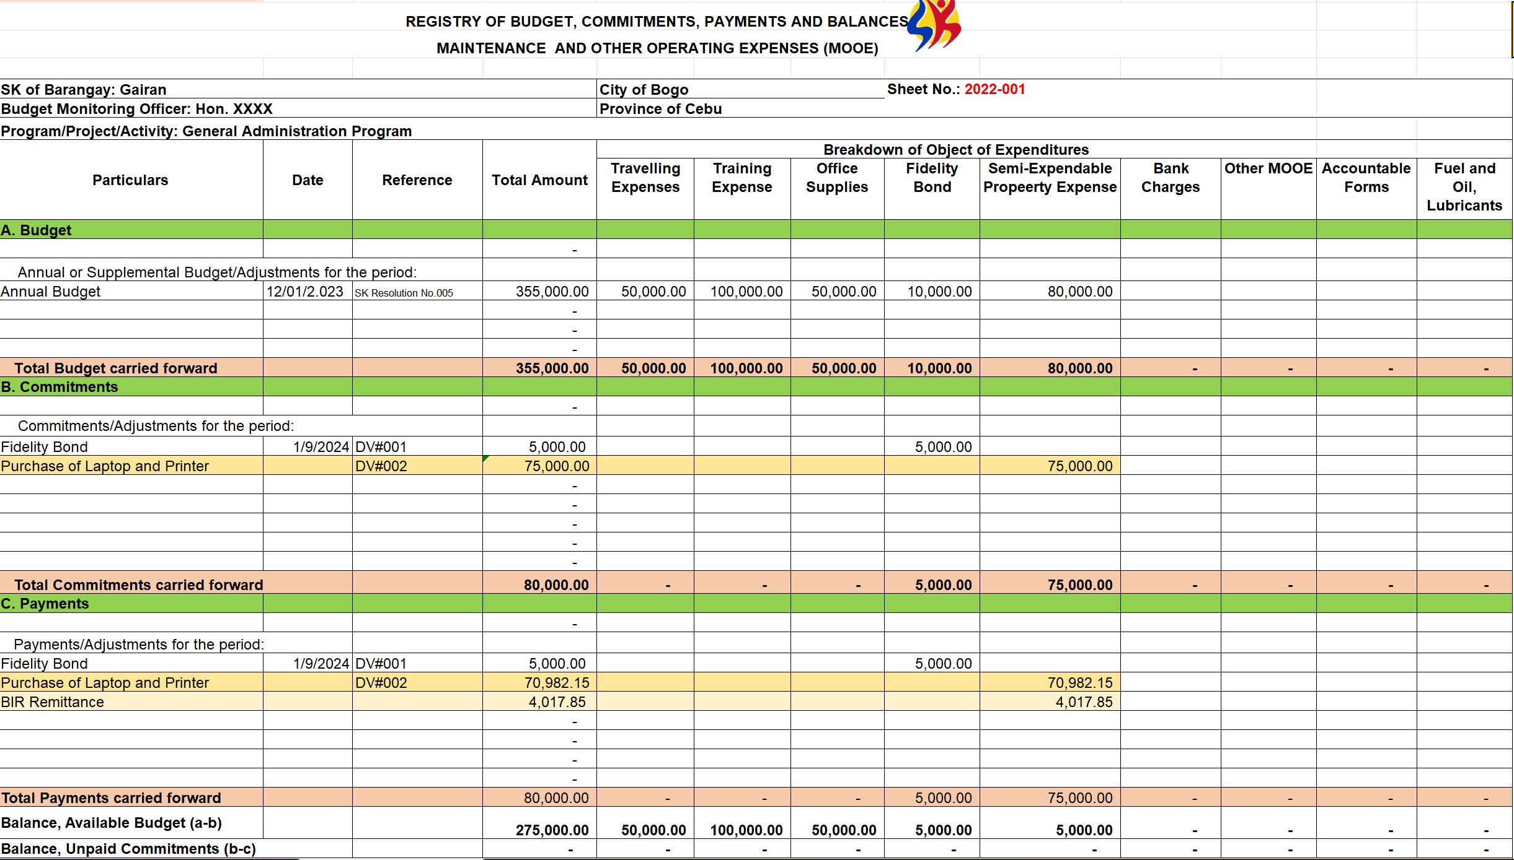
How recorded in the RBCPB?
COA’s version:

Slide 109


How recorded in the RCB?
My version:
COA’s version

Slide 110

How reported in SBCPB?

Slide 111
How reported in SCBAA?
Transaction : | Cash advance of SK Treasurer for the monthly honoraria of SK Officials with an amount of P1,000 per official. (9 officials)

Slide 112
How reported in QSRP?
Transaction : | Cash advance of SK Treasurer for the monthly honoraria of SK Officials with an amount of P1,000 per official. (9 officials)

Slide 113

POLICIES FOR SUPPLIES AND MATERIALS

Slide 114

POLICIES FOR SUPPLIES AND MATERIALS

Slide 115

POLICIES FOR SUPPLIES AND MATERIALS

Slide 116

POLICIES FOR SUPPLIES AND MATERIALS

Slide 117

POLICIES FOR SUPPLIES AND MATERIALS

Slide 118

POLICIES FOR SUPPLIES AND MATERIALS

Slide 119

POLICIES FOR SUPPLIES AND MATERIALS

Slide 120

POLICIES FOR PROPERTY & EQUIPMENT

Slide 121

POLICIES FOR PROPERTY & EQUIPMENT

Slide 122

POLICIES FOR PROPERTY & EQUIPMENT

Slide 123

POLICIES FOR PROPERTY & EQUIPMENT

Slide 124

POLICIES FOR PROPERTY & EQUIPMENT

Slide 125

POLICIES FOR PROPERTY & EQUIPMENT

Slide 126

THANK YOU
Notes:
This is all for our overview. We are now open for your questions. Let us now request our host _____________ to read some of the questions that you sent through the chat box.
Since our time is limited, we could only accommodate some, but the answer to all your questions shall be emailed to you together with you certificates and materials.
Let me now return the platform to our facilitator. Thank you.

